Slide 1
Tribute to the carrier of Larry Coldren
Widely Tunable InP PICs: Generations of High Volume Manufacturing
High Volume VCSEL Industrialization
March 16, 2018

Slide 2
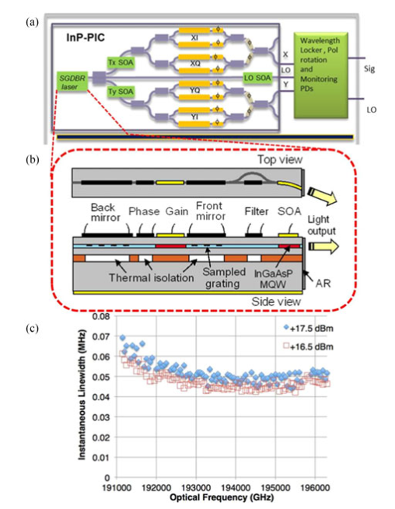
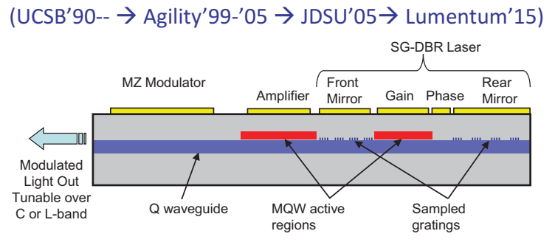
Tunable InP PICs: Generations of High Volume Manufacturing
SGDBR laser and PICs based on it solved multiple problems for telecom components and enable widely tunable pluggable XFP and SFP+ transceivers for Metro and LH
Reduced size, cost, and power dissipation
Enhanced reliability
C or L-band tuning
High performance optical transmitters when integrated with modulators
SOA integration provided additional functionality
Technology will continue enabling coherent DCI and eventually intra-datacenter applications

Slide 3
High Volume VCSEL Industrialization
2018 March 16

Slide 4
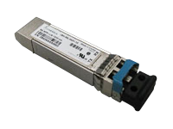
The first wave of industrialization... 1998 to 2016
Early 1990s Larry’s seminal VCSEL work
Mid 1990s Industry R+D: Honeywell, Hewlett-Packard, Picolight now part of Finisar, Broadcom and Lumentum
1998 Gigabit Ethernet Standard adopts VCSELs + Multimode Fiber
Late 1990s 1st high volume manufacture: Millions VCSELs / year
10Gb/s
Mid-2000s VCSELs in mice (by Avago formerly HP)
25Gb/s
2014 VCSELs as 1-D sensors in phones (Phillips)
 | Application | Used in | Die Size mm² | Annual Volume | Emitters per chip | Wafer Size
1st Wave | Data Comm. 1 – 50 Gb/s | Transceivers Over Multi-Mode Fiber | ~0.25² per emitter | ~10M | 1 to 4 | 3 inch or 4 inch
 | Sensing (single beam) | Optical Mice, Mobile phones | ~0.15² | 10M – 100M
50Gb/s

Slide 5
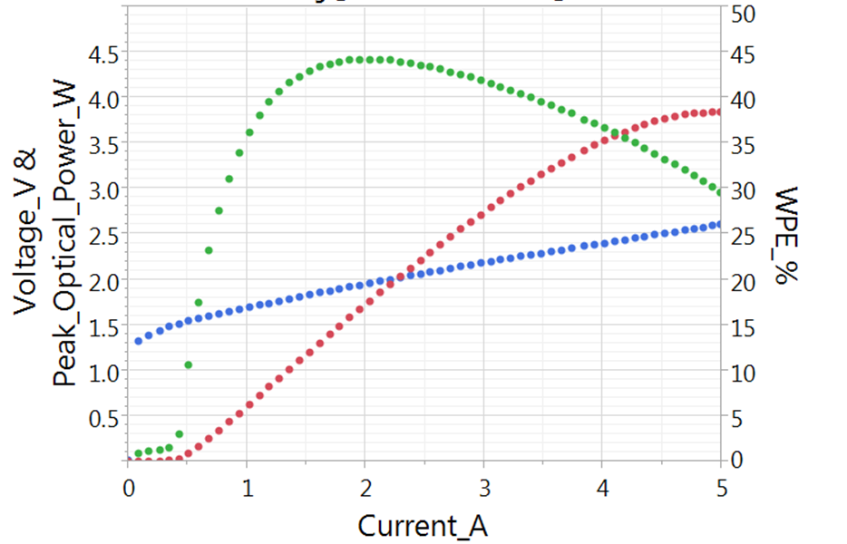
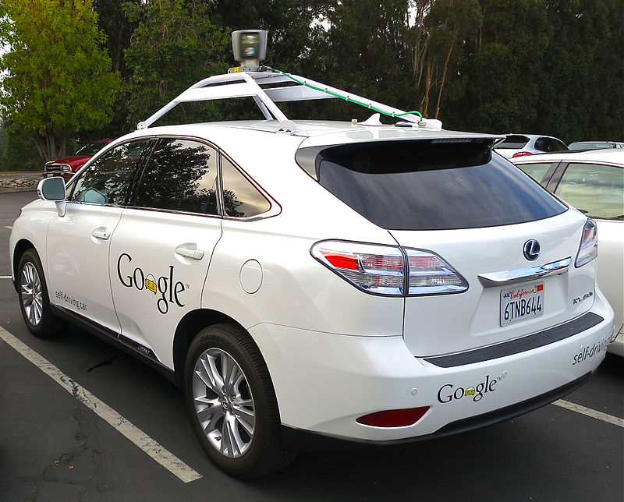
The second wave of industrialization... 2017 and beyond
2017 VCSEL arrays for 3D –sensing in mobile phones
Large (mm scale) die, High volumes
Optical beam characteristics, wall-plug efficiency critical
202x VCSEL arrays for 3D sensing in cars? + what else?
Lumentum
VCSEL array
> 40% Wall-Plug Efficiency > 3W optical power
 | Application | Used in | Die Size mm² | Annual Volume | Emitters per chip | Wafer Size
2nd Wave | 3D Sensing (multi-beam) | Mobile phones and tbd | ~ 1 | 30M – 300M | >100 | 6 inch

Slide 6
Larry’s Legacy
Many design features first demonstrated by Larry’s group appear in commercial VCSELs today
Gain-Offset design (Improved performance over temperature)
Flattening of band-offsets in mirrors (Lower voltage)
Gold plating of VCSELs (lower thermal resistance)
Thin and Tapered dielectric apertures (Optical mode + Structural control)
Four of Larry’s graduates led VCSEL 3D-Sensing chip development at Lumentum
Number of emitters in VCSEL array chips produced in 2017 by Lumentum is over 20 Billion
“Thanks a billion, Larry, and congratulations.”
Eric Hegblom, Ajit Barve, Matt Peters, Jay Skidmore & the rest of Lumentum

Slide 7
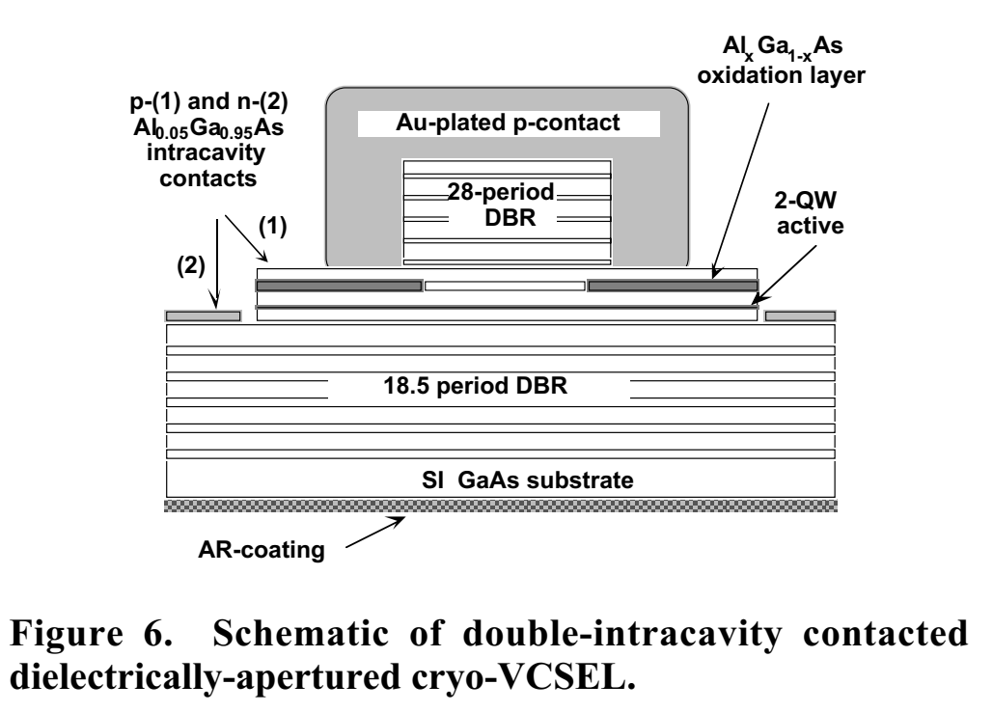
Book and more
Go To book for many researches and engineers who develop lasers and PICs
Larry’s ideas had profound impact on Optical data transmission industry and his influence was amplified by generations of students who advanced Telecom, Datacom, and consumer optics in the last 20+ years
Larry,
On behalf of all students
Thank you!

