Slide 1
Congratulation for Symposium on Tribute to the Career of Professor Larry Coldren
2018-3-16
Yasuharu Suematsu
Honorary Professor
Tokyo Institute of Technology

Slide 2
1986-6-12 Int. Work. Sem. Laser. SanFrancisco

Slide 3
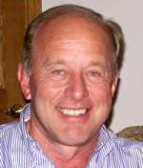
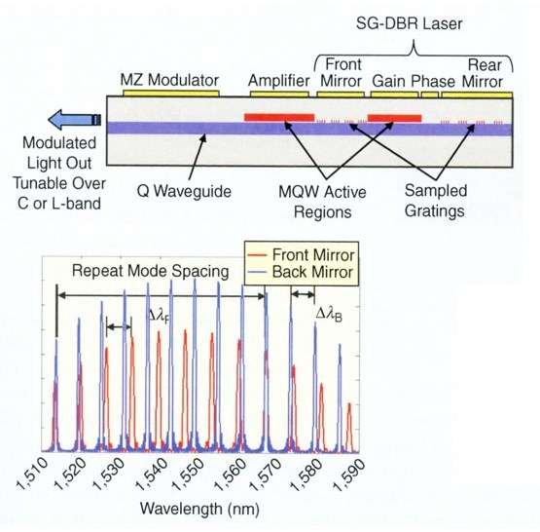
■ Widely Tunable Sampled-Grating DBR-Laser with SOA-Modulator PICs
Sampled-Grating DBR Laser in 1993.
Wide Tunability by Vernier Effect over 40nm.
Commercialization of Electro-Tunable Laser, in 2004.
Electro-Tunable Laser
Prof. Larry Coldren
By Courtesy of Prof. L. A. Coldren
“Semiconductor Laser Advances,”
IEEE Photonic Res. Advances,
Feb., 2011

Slide 4
Greatly Appreciated for Commercialization of Electro-Tunable Lasers

Slide 5
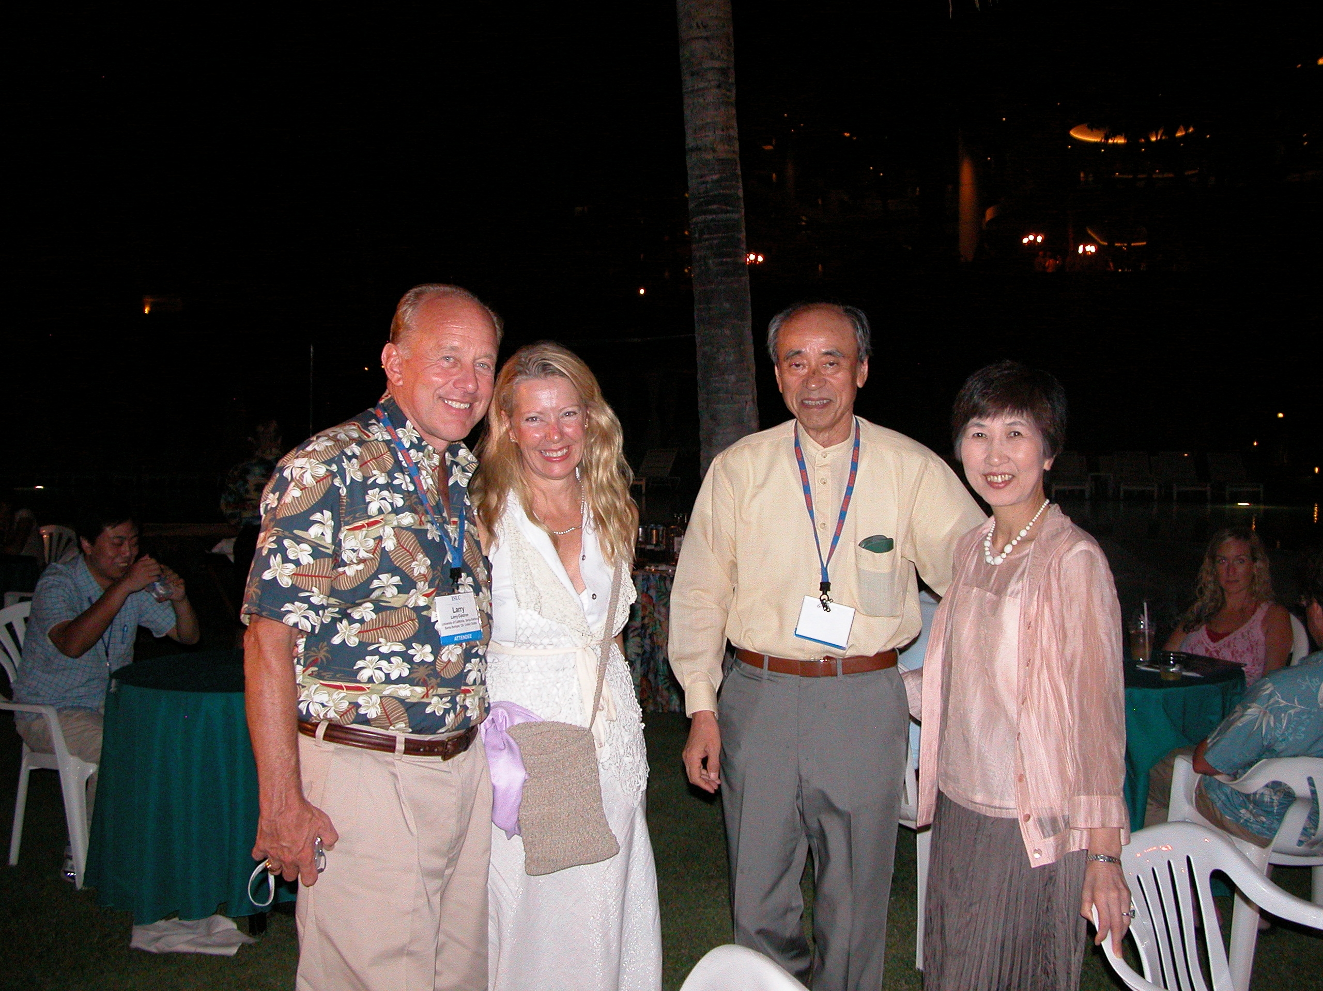
2006-9-20 20th Anniversary ISLC, Hawaii

Slide 6
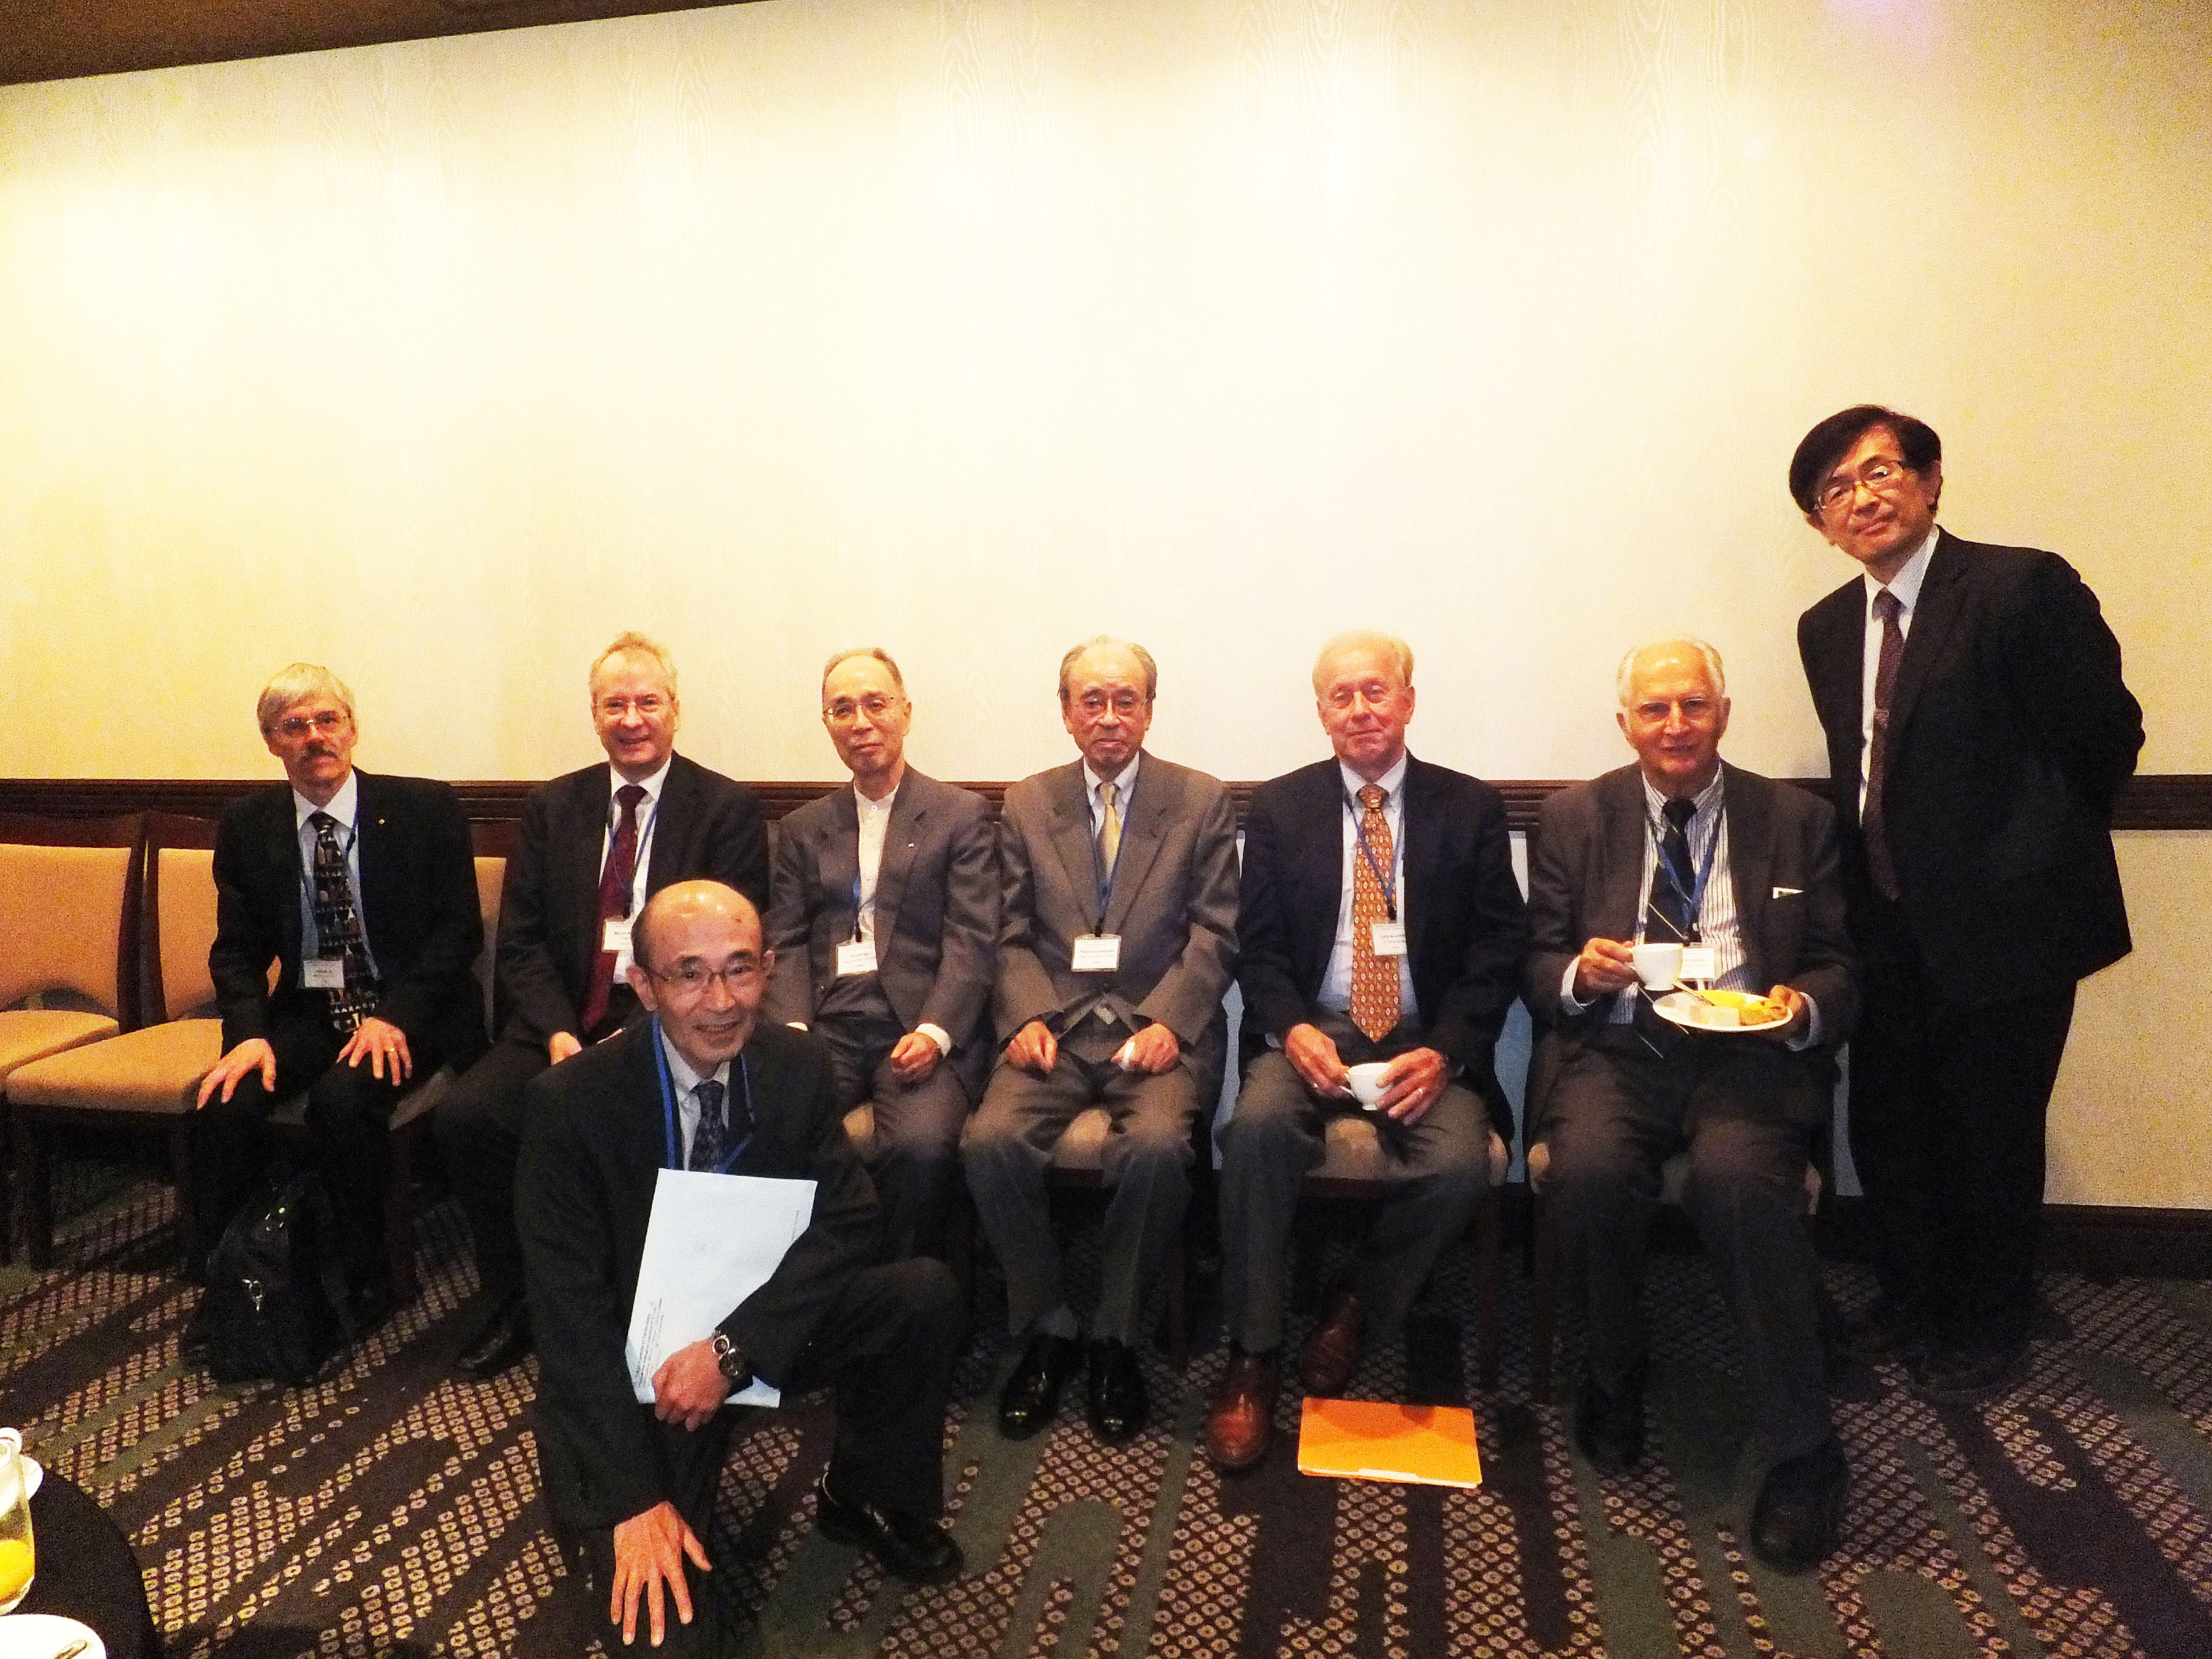
2012-11-6 40th Anniversary SMSL, Tokyo

Slide 7
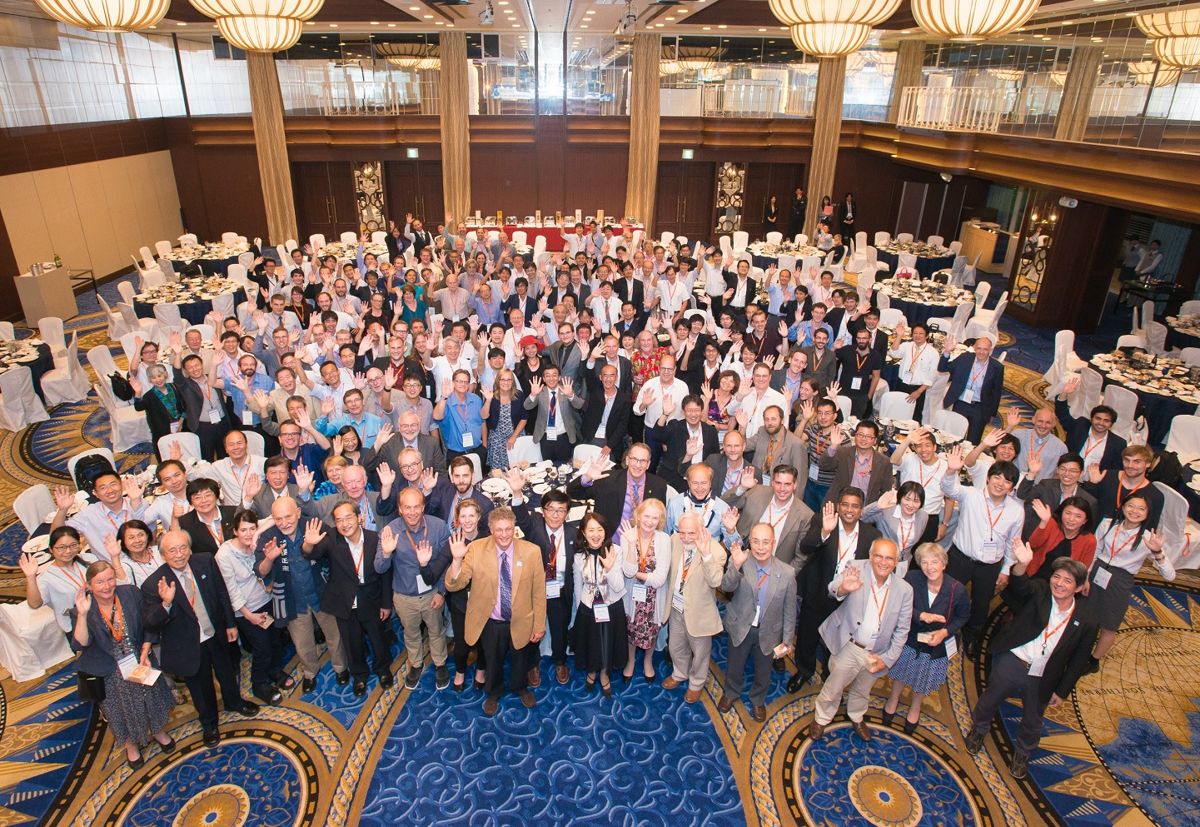
2016-9-14 50th Anniversary ISLC-25 Kobe

Slide 8
■Quantitatively drastic advancement of ICT could produced Qualitative changes in Society ?
Past drastic Advancements:
Quantitatively by the order of multi-million times
Optical Fiber: 100 million times compared Electric Cable
Data on Clouds: 100 million times compared National Diet Library
Computer : 10 million times compared half a century ago
Future Extraneous Society ??
above drastic advancements could produce Qualitative Changes;
Net-Linked World ~Long Life ?
Cloud captured Individual Action ~Novel Business ?
IoT-Organized Earth ~System Safety ?
Global Net-Tied Brain ~Smart Idea ?
AI assisted Work ~Wide Scope ?

Slide 9
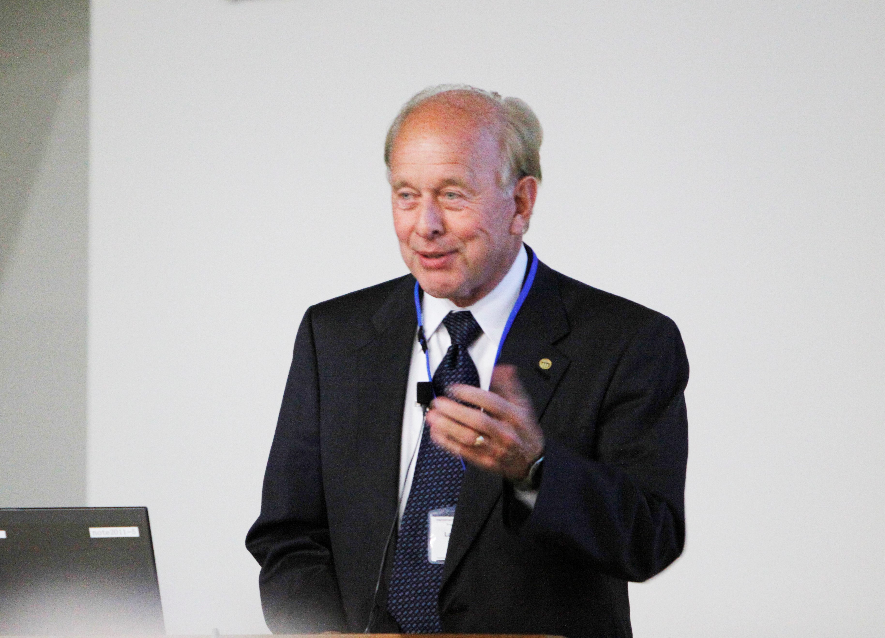
Congratulation for Professor
Larry Coldren

