Slide 1
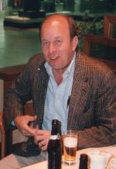
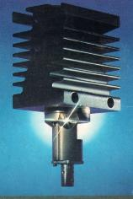
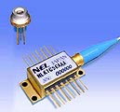
A History of LD for Optical Communication in NTT
-Platform of INTERNET Society-
Larry Coldren Symposium, 16 March ‘18
Tetsu IKEGAMI
Advisor NTT etc.
President of LEOS in 1994
President, NTT Labs, 1996
tetsu-ikegami@poplar.ocn.ne.jp
Access to: britta@engineering.ucsb.edu
DFB LD Δf 80 kHz
1971
2018

Slide 2
What we learn from OFC ‘18
Plenary Talks, 13 March 2018, San Diego
M. Weldon, Nokia Bell Labs, USA
Chengliang Zhang, China Telecom
Beijing Research Institute
”The Future of Deterministic
Dynamic Networking”
”Optical NWing in the Cloud
and 5G Era”
Low power
Low cost
Integration
Spectrum
工欲善其“事” 必先利其“器”
by 孔子 (Confucius)
To accomplish the MISSION, one must sharpen his TOOLs
Frequency
Efficiency
Space
(Distance, NWing)

Slide 3
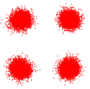
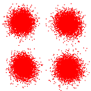

Post deadline paper (OFC 2018) by NTT Lab
Th4A.2. Y. Ogiso et.al., “Ultra-High Bandwidth InP IQ Modulator
co-assembled with Driver IC for Beyond 100-GBd CDM”
High gain peaking design
□ Up to 128-GBd QPSK
□ 112-GBd 16QAM
EO response (dB)
112 GBd
120 GBd
128 GBd
Frequency (GHz)
OSNR: 29.5 dB
BER: Error free
OSNR: 29.2 dB
BER: 3.83×10⁻⁵
OSNR: 29.5 dB
BER: 6.68×10⁻³
I ch.
Q ch.

Slide 4
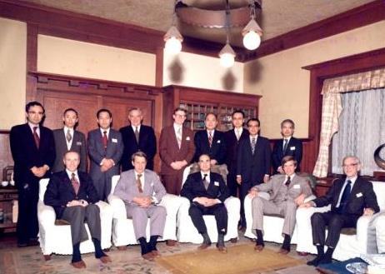
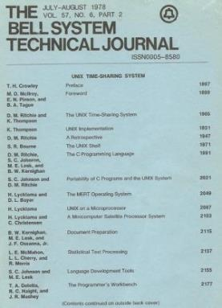
Top Leader in Communication
AT&T/ Bell Labs/Western Electric
Battle against FCC, Break-up in 1985
L. Coldren ;
one of Legacies of Bell Lab.
Executive Meeting
NTT, WE & Bell Labs
Bible of R&D
1977, Tokyo
S. E, Miller
Concept of PIC
BSTJ ‘78 , LINAX Time Sharing Sys. !
Reference on Bell Labs, Use to be
J. Morton (Bell Lab) “Organizing for Innovation” (1970)
W. Brooke Tunstall “Disconnecting Parties” (1985)
P. Temin, “The Fall of Bell System –A Study in Price and Politics- “ (1987)
J. Gertner, “The idea Factory –Bell Labs and Great Age of American Innovation” (2012)

Slide 5
Number of LD Papers in Conference
“Just P-N Junction LD” was a Star in ‘70s and ‘80s
1st ECOC (London, 1975）LD direct modulation (T. Ikegami)
3rd ECOC (Munich,1977) Fiber/Cable 30, LD 14
  Monomode fiber is promising (D. Marcuse) referring “connection loss, less than .2db by fusion splicing” (NTT, Feb.’76 Williamsburg)
8th ECOC (Cannes,1982) Fiber/Cable 39, LD 22, System 55
  WDM, Connector
  1.5μｍ Trans. with DFB-LD, Single-mode Fiber 104Km, @400Mb/s(NTT)
IOOC (Tokyo, ‘83) Fiber/Cable 61, LD 40, System 42
  OEIC(I. Hayashi); LiNbO₃, “not easy”
  Hard Screening (Ea, .7 eV-> .2 eV)
  Transmission Competition (Bit rate $ Distance)
OFC (San Diego, ‘96) LD(device only) 0 !
  Er doped Fiber Amp.(EDFA)
  VCL 1.54μｍ, 1Gb/s

Slide 6
History of LD
Direct Modulation of LD (my Doctor thesis , 1967)
  “Up to 400 MHz “ (1975, ECOC)
Room Temperature CW operation at short-wave length (Bell Lab, 1980)
Shift to long-wave length, since Fiber loss minimum
  Low connection loss by fusion (NTT,1977) , Mono-mode fiber could promising (ECOC ‘77)
Mode-partition noise (NTT,1975)
  Answer to “How degree single-mode oscillation under direct-modulation is necessary?”
  VICSEL could be answer, but Implementation ? Larry did !
Decided to use DFB LD (NTT,1982)
  Fabry-Perot to Grating-index
  “Ikegami became crazy, it’s just toy”
Competition of Transmission Capacity
Reliability; “Hard screening method”, leaved from Activation-energy theory (NTT,1985)
In ‘90’s

Slide 7
History of LD
Direct Modulation of LD (my Doctor thesis , 1967)
  I said “Direct modulation possible up to 400 MHz “ (1975, #1 ECOC, London)
Room Temperature CW operation at short-wave length (Hayashi & Panish､Alferov1970)
Shift to long-wave length, since Fiber loss minimum
  Low connection loss by fusion (NTT,1977) , Mono-mode fiber could promising (ECOC ‘77)
Mode-partition noise (NTT,1975)
  Answer to “How degree single-mode oscillation under direct-modulation is necessary?”
  VICSEL could be answer, but Implementation ? Larry did !
Decided to use DFB LD (NTT,1982)
  Fabry-Perot to Grating-index
  “Ikegami became crazy, it’s just toy”
Competition of Transmission Capacity
Reliability; “Hard screening method”, leaved from Activation-energy theory (NTT,1985)
In ‘90’s

Slide 8
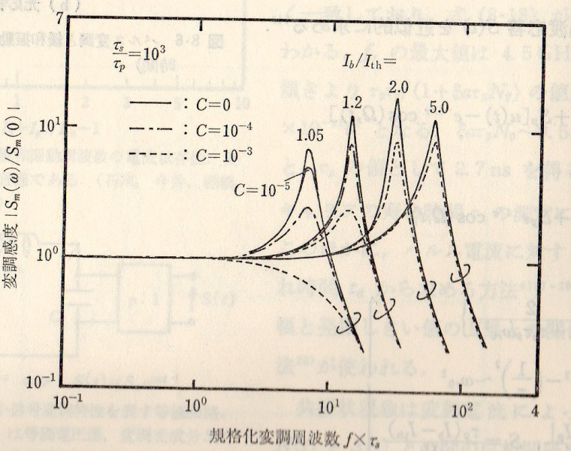
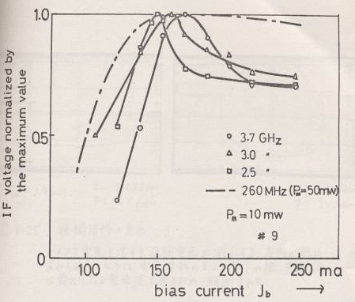
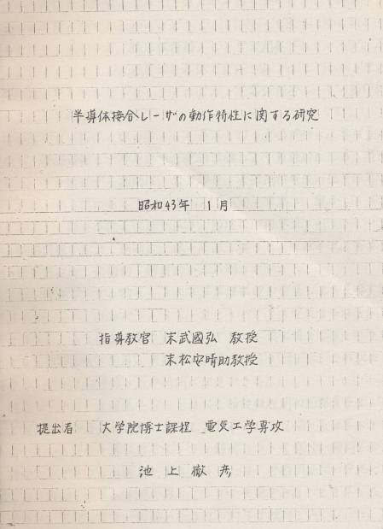
Direct Modulation of Laser Diode (1967)
T. Ikegami & Y. Suematsu,”Resonance-Like characteristics
of the Direct Modulation of a Junction Laser” Proc, IEEE 55,Jan. 1967
Doctor Thesis
Bias Current
Intensity
Modulation Frequency
Bias Current
Resonance-Like phenomena
In Microwave Modulation

Slide 9
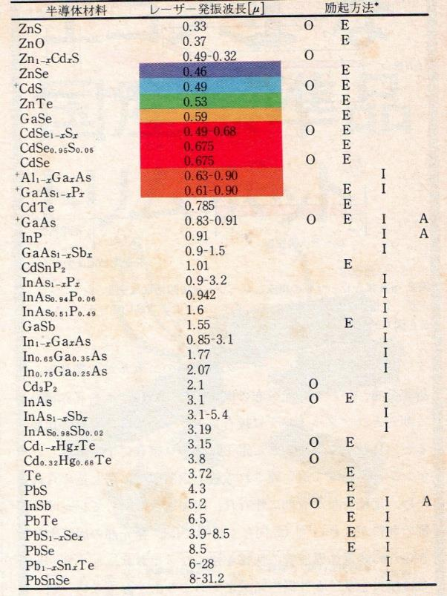
LD Oscillation at Aug. 1971
Oscillation Wavelength
*
Bell Labs tried “GaAsSb”
GaN not here
NTT Lab like “In“, Lucky !
“In” is a key material in Blue LD
(S. Nakamura, InGaN ‘94)
*Pumping Method
O: Optical
E: Electron
I: Injection
A:Avalanche
Note; In 1962 N. Holonyack first succeeded in
Visible Red LD (‘62), GaAsP

Slide 10
History of LD
Direct Modulation of LD (my Doctor thesis , 1967)
  I said “Direct modulation possible up to 400 MHz “ (1975, ECOC)
Room Temperature CW operation at short-wave length (Bell Lab; Hayashi & Panish､ Alferov, 1970)
Shift to long-wave length, since Fiber loss minimum
  Low connection loss by fusion (NTT,1976) , Mono-mode fiber could promising (ECOC ‘76)
Mode-partition noise (NTT,1975)
  Answer to “How degree single-mode oscillation under direct-modulation is necessary?”
  VICSEL could be answer, but Implementation ? Larry did !
Decided to use DFB LD (NTT,1982)
  Fabry-Perot to Grating-index
  “Ikegami became crazy, it’s just toy”
Competition of Transmission Capacity
Reliability; “Hard screening method”, leaved from Activation-energy theory (NTT,1985)
In ‘90’s

Slide 11
History of LD
Direct Modulation of LD (my Doctor thesis , 1967)
  “Up to 400 MHz “(1975, ECOC)
Room Temperature CW operation at short-wave length(Bell Lab, 1970)
Shift to long-wave length, since Fiber loss minimum
  Low fiber connection loss by fusion (NTT,1976) , Mono-mode fiber could promising (Bell Lab, Marcateri ECOC ’76, Munich)
Mode-partition noise(NTT,1975)
  Answer to “How degree single-mode oscillation under direct-modulation is necessary?”
  VICSEL could be answer, but Implementation ? Larry did !
Decided to use DFB LD (NTT,1982)
  Fabry-Perot to Grating-index
  “Ikegami became crazy, it’s just toy”
Competition of Transmission Capacity
Reliability; “Hard screening method”, leaved from Activation-energy theory (NTT,1985)
In ‘90’s

Slide 12
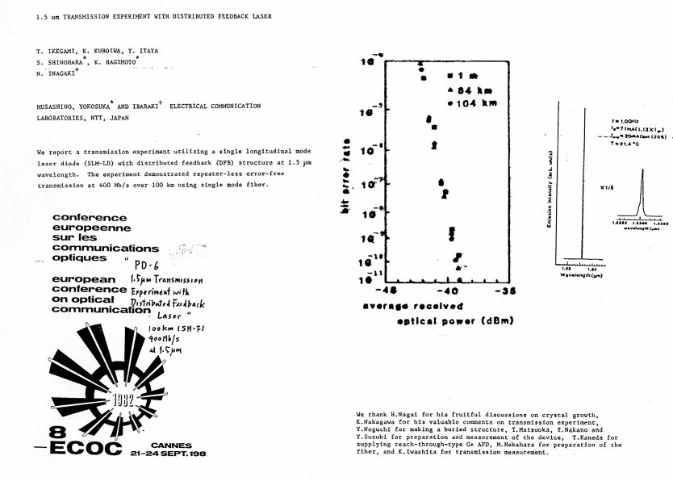
1.5um Transmission Experiment with DFB LD, 104km @ 400Mb/s, Normal SM Fiber (1982)
Post Deadline Paper @ ECOC’82, Cannes
Just experiment without Dispersion compensation of SM fiber but gave big Impact

Slide 13
History of LD
Direct Modulation of LD (my Doctor thesis , 1967)
  “Up to 400 MHz “(1975, ECOC)
Room Temperature CW operation at short-wave length(Bell Lab, 1970)
Shift to long-wave length, since Fiber loss minimum
  Low connection loss by fusion (NTT, 1976) , Mono-mode fiber could promising (ECOC ’76, Munich)
Mode-partition noise (NTT,1975)
  Answer to “How degree single-mode oscillation under direct-modulation is necessary?”
  VCSEL could be answer, but Implementation ? Larry did !
Decided to use DFB LD (NTT,1982)
  Fabry-Perot to Grating-index
  “Ikegami became crazy, it’s just toy”
Competition of Transmission Capacity
Reliability; “Hard screening method”, leaved from Activation-energy theory (NTT,1985)
In ‘90’s

Slide 14
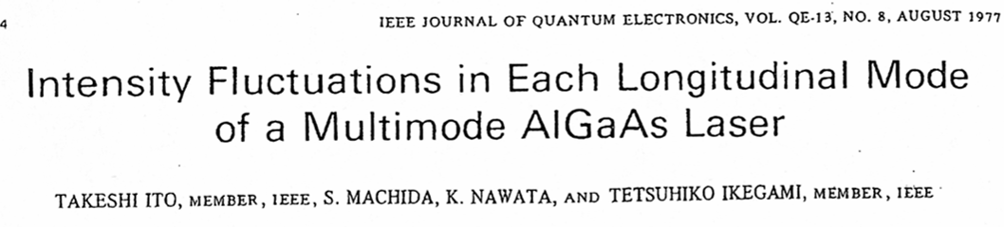
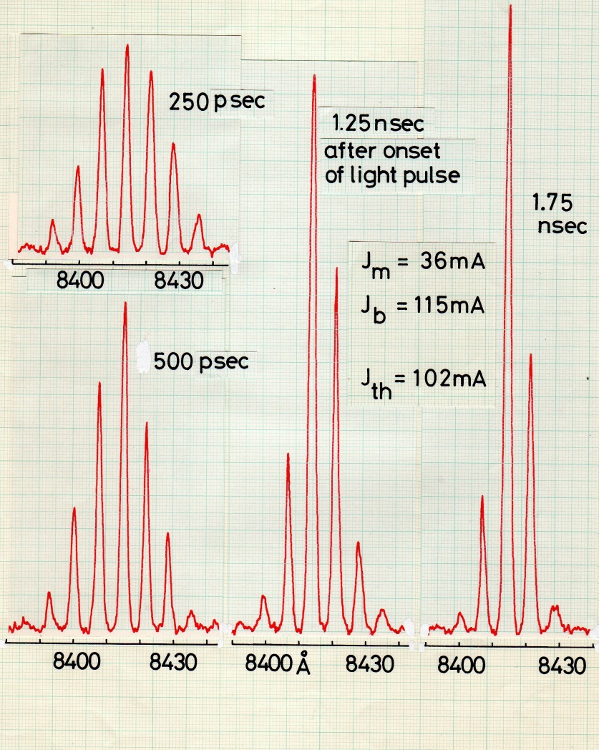

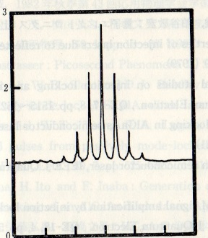
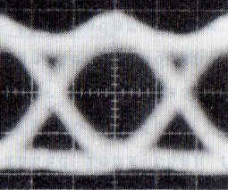
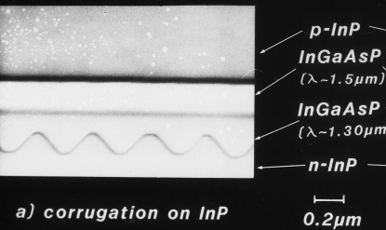
Mode Partition Noise (1975)
Time resolved response measurement showed ;
Shape of Multi-mode spectrum was Random !
Random Noise (Cannot Compensate)
Noise Closes Eye-pattern in Digital Transmission
Decided to use DFB LD for coming over the Noise (‘82) in real (commercial) system
“Ikegami became crazy, it is just a toy”
System people like 2 terminal rather than
3 terminal (Lobby discussion, IOOC’83)
Only Bell Lab. (K. Ogawa)
understand the Noise

Slide 15
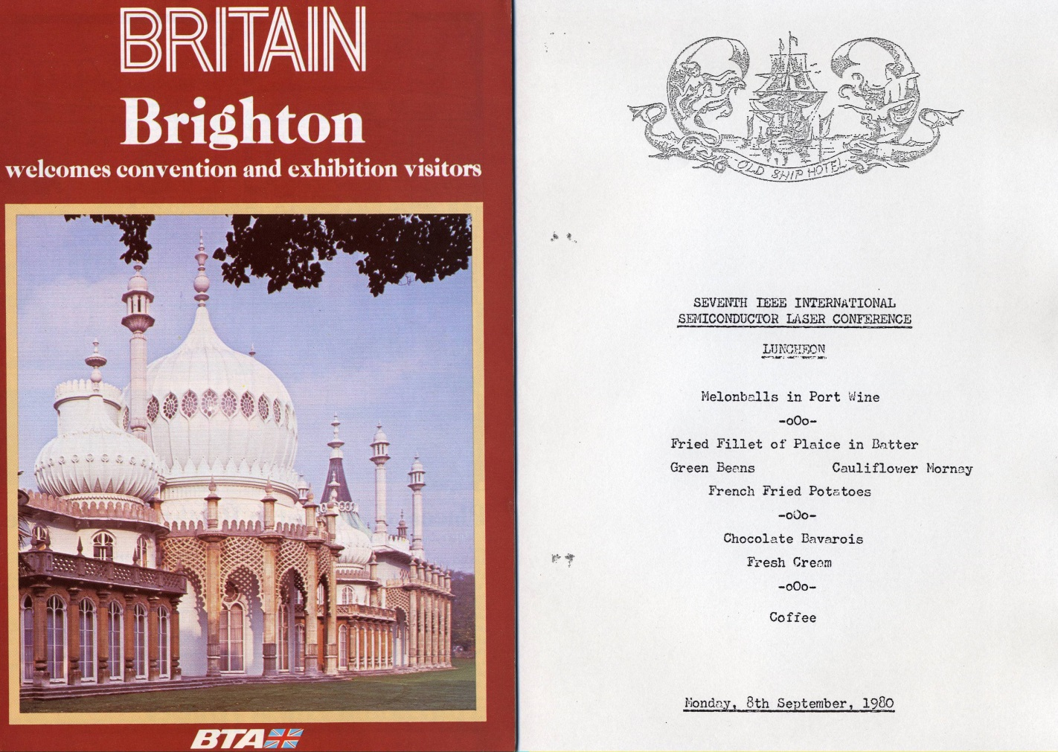
Move to Longwave Length (‘80)
Japan became leader in LD R&D
All Papers on InGaAsP LD from Japan were arranged in Poster Session! Why?
Answer to my Claim to Program Committee;
“For Fruitful Discussion (since Japanese presenter’s poor English)”

Slide 16
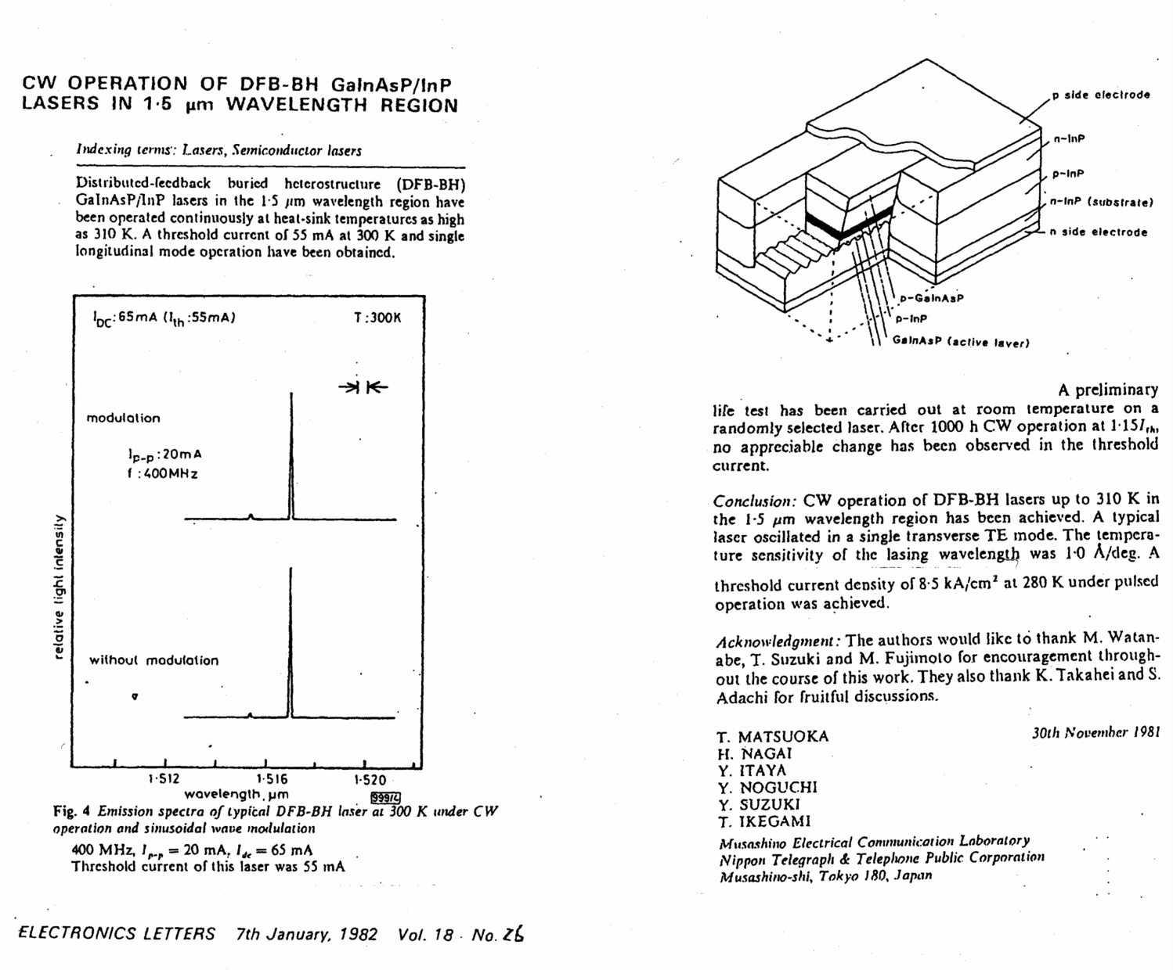
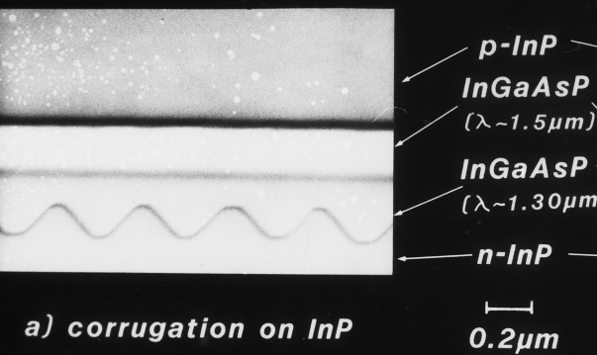
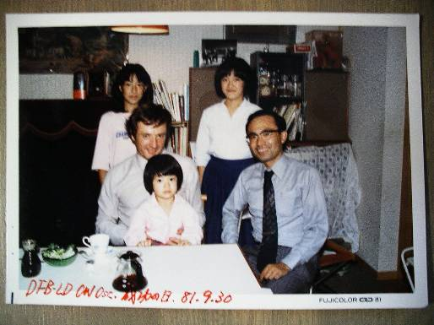
CW Operation of 1500nm DFB Sept. 1981
Just Experiment in Lab !
Witness; J. C. Bouly (France Telecon)

Slide 17
History of LD
Direct Modulation of LD (my Doctor thesis , 1967)
  “Up to 400 MHz “(1975, ECOC)
Room Temperature CW operation at short-wave length (Bell Lab, 1970)
Shift to long-wave length, since Fiber loss minimum
  Low connection loss by fusion (NTT,1976) , Mono-mode fiber could promising (ECOC ‘76)
Mode-partition noise(NTT,1975)
  Answer to “How degree single-mode oscillation under direct-modulation is necessary?”
  VICSEL could be answer, but Implementation ? Larry did !
Decided to use DFB LD(NTT,1982)
  Fabry-Perot to Grating-index
  “Ikegami became crazy, it’s just toy”
Competition of Transmission Capacity
Reliability; “Hard screening method”, leaved from Activation-energy theory(NTT,1985)
In ‘90’s
We enjoyed competition without Optical-amplifier (pumped by LD) / LDA which overcome penalty of functions

Slide 18
History of LD
Direct Modulation of LD (my Doctor thesis , 1967)
  “Up to 400 MHz “(1975, ECOC)
Room Temperature CW operation at short-wave length (Bell Lab, 1970)
Shift to long-wave length, since Fiber loss minimum
  Low connection loss by fusion (NTT,1976) , Mono-mode fiber could promising (ECOC ‘76)
Mode-partition noise(NTT,1975)
  Answer to “How degree single-mode oscillation under direct-modulation is necessary?”
  VICSEL could be answer, but Implementation ? Larry did !
Decided to use DFB LD(NTT,1982)
  Fabry-Perot to Grating-index
  “Ikegami became crazy, it’s just toy”
Competition of Transmission Capacity
Reliability; “Hard screening method”, leaved from Activation-energy theory(NTT,1985)
In ‘90’s
We enjoyed competition without Optical-amplifier(pumped by LD) /LDA which overcome penalty of functions
INTERNET Society (1998~ )
Laser is widely used in our life, CD, etc.
PIC is common technology in Optical NWing and will be common technology in Robotics/AI era

Slide 19
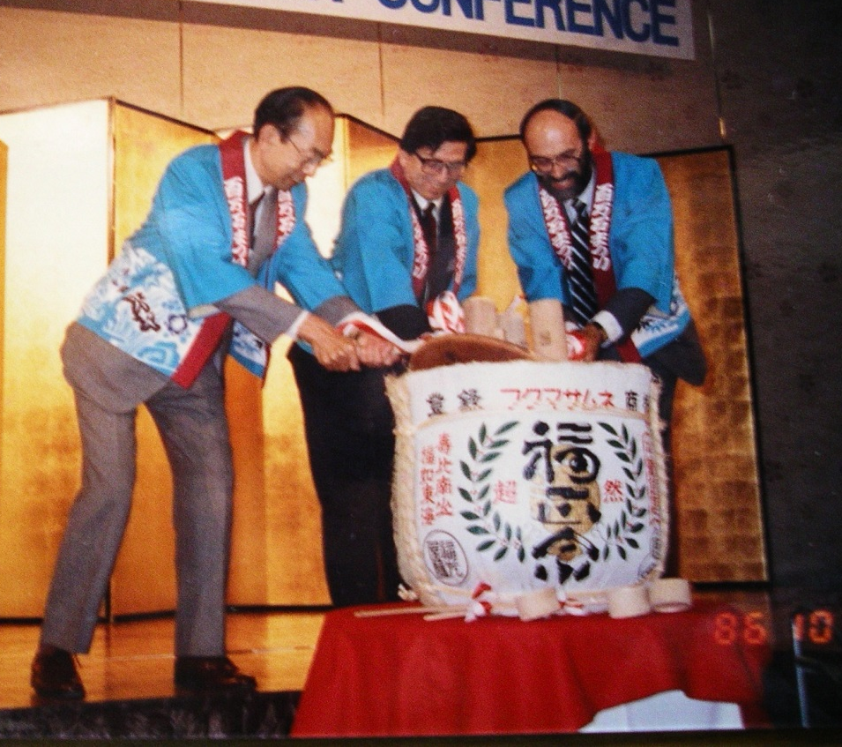
Reliability (1)
Very, very tough work for researches (Bell Lab & NTT Lab)
The First Generation in Bell Labs (Hayashi, Panish) were “PURGED”
The Second Generation (D. Dixon) succeeded in “stable” GaAlAs LD (1980)
“Do it Properly, you can get it” was answer to “How to make it ?” (#7 ISLC ’80)
The Third Generation (Gordon) had to collaborate with Hitachi to get InGaAsP for Reliability Test
NTT succeeded in Getting “Stable” InGaAsP LD by Screening Method(1983)
Hayashi’s Group succeeded in
Room Temperature CW Operation (‘70)

Slide 20
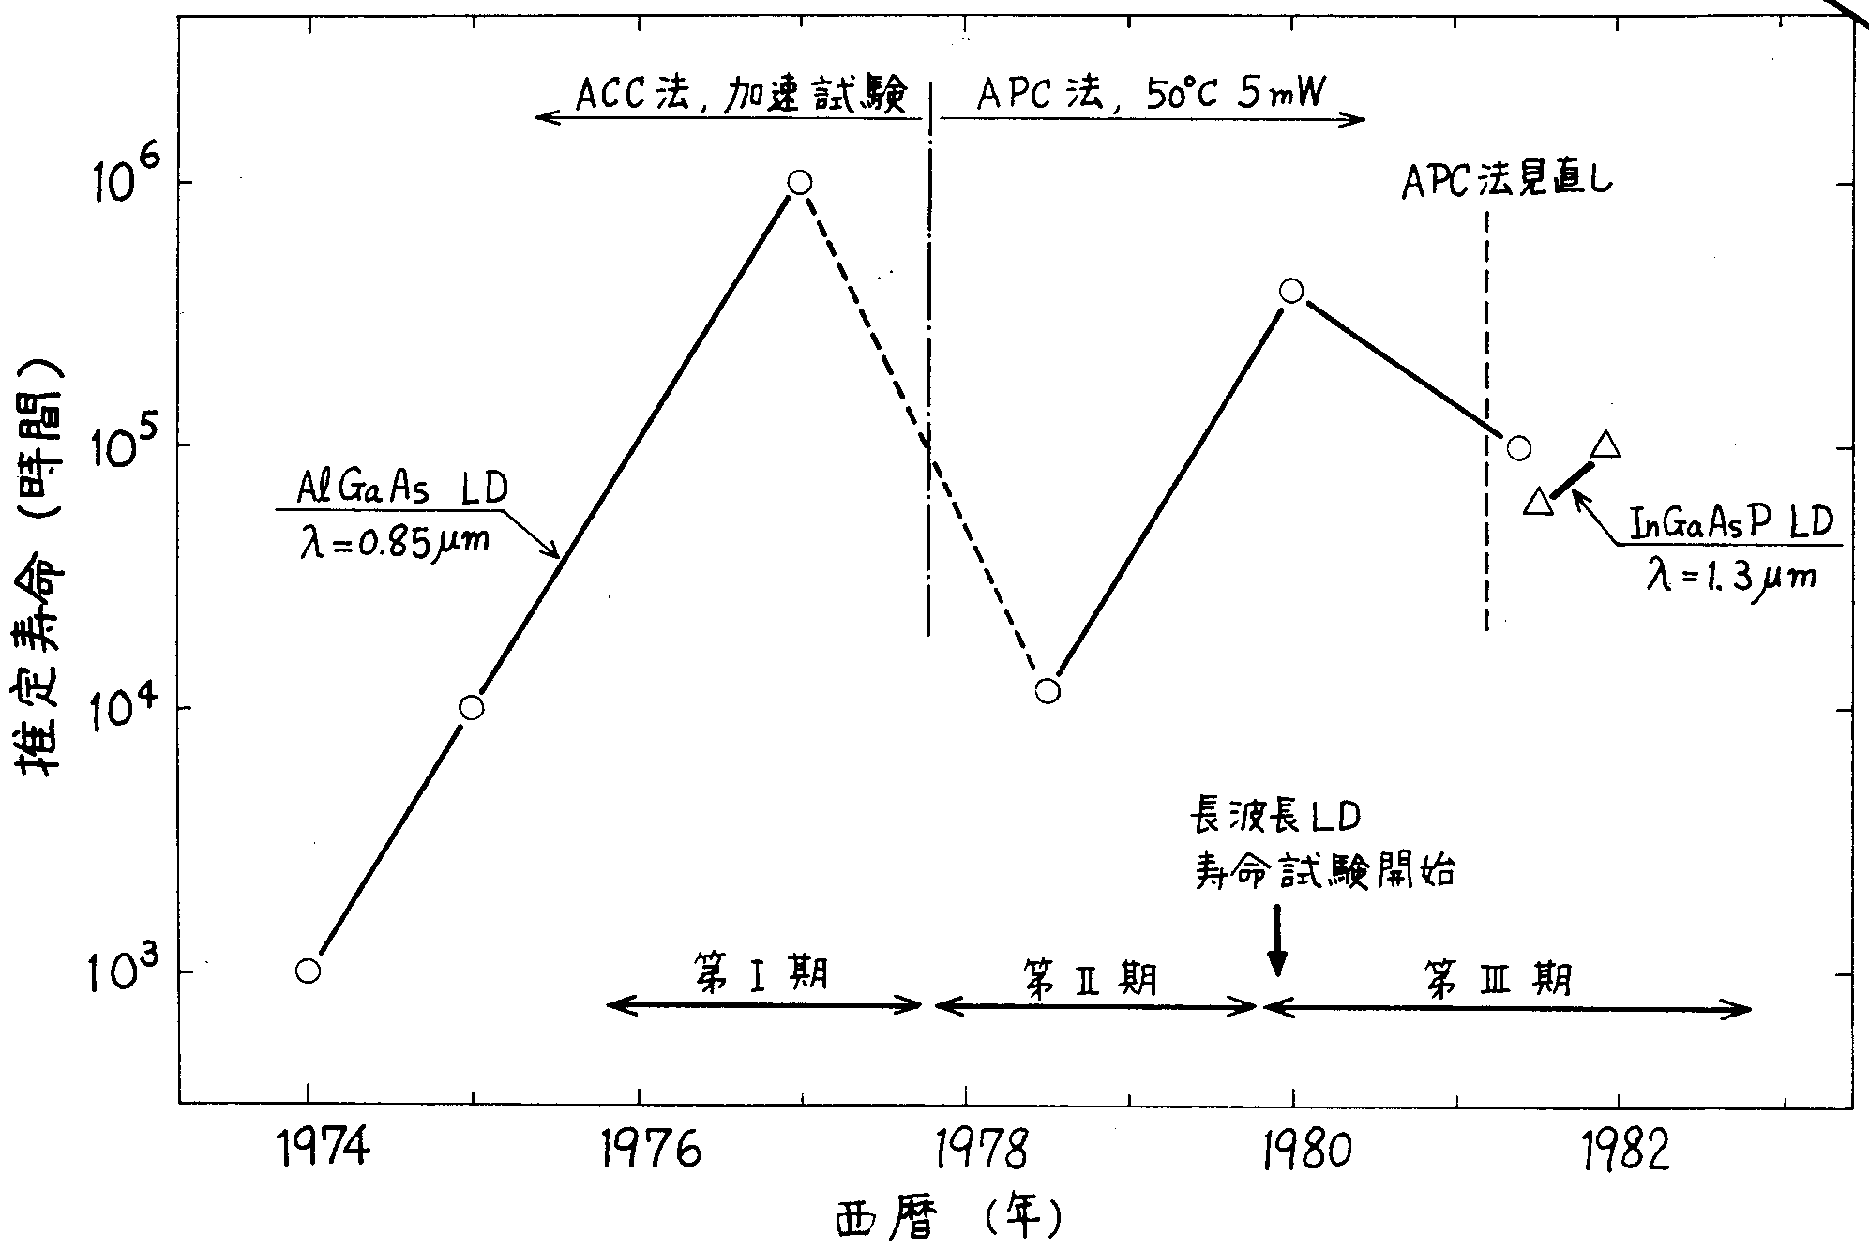
Reliability (2)
Screening Method
(1983)
Life Estimation
By “Activation Energy”
1 Mil. hrs.
GaAlAs LD
InGaAs LD
Estimated Lifetime
Chaos
10 k hrs.
“Bell Lab’s Time”
“NTT Lab’s Time”
Report in NTT at 1981

Slide 21
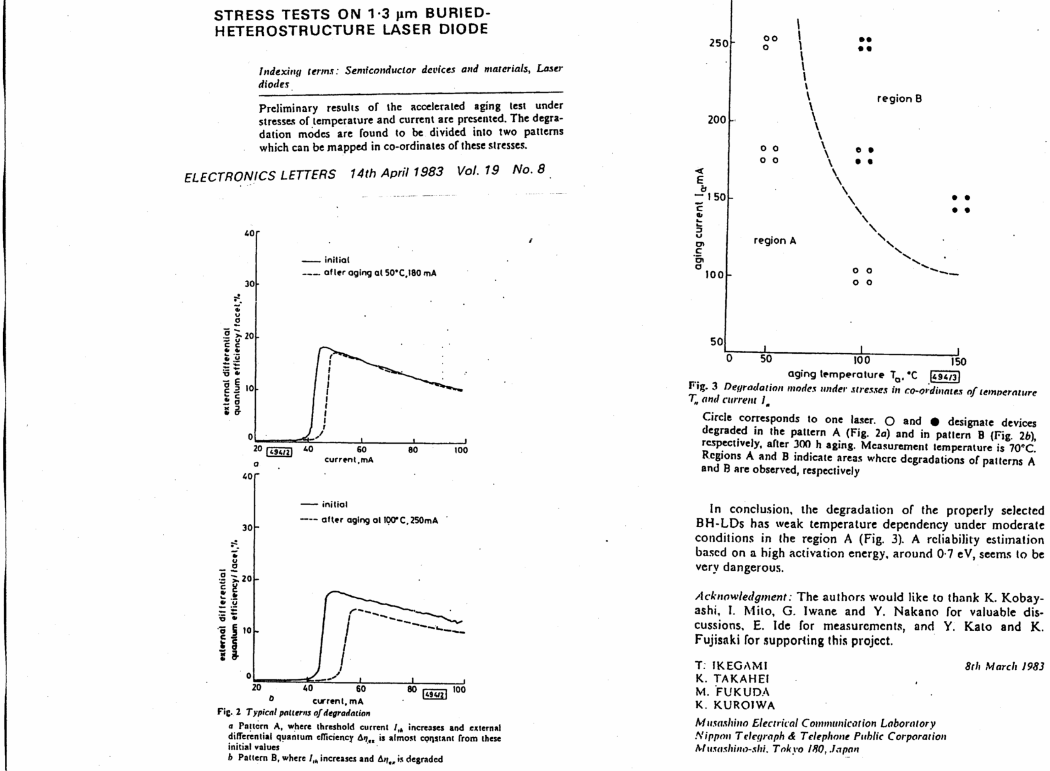
Reliability (3)
Screening Method (‘83)
Pre-selection of long life LD
by Non-destructive Stress Test
Common method
in industrial product
Note;
Traditional Lifetime-Estimation
Supposing Failure Distribution is Log-Normal
This method make sense in case of One Failure Mode
but reality is Many Failure Modes
(electrode, Facet, DH etc.)
Dangerous !
Aging Current
Safety Condition
Aging Temp.

Slide 22
History of LD
Direct Modulation of LD (my Doctor thesis , 1967)
  “Up to 400 MHz “(1975, ECOC)
Room Temperature CW operation at short-wave length(Bell Lab, 1970)
Shift to long-wave length, since Fiber loss minimum
  Low connection loss by fusion (NTT,1976) , Mono-mode fiber could promising (ECOC ‘76)
Mode-partition noise(NTT,1975)
  Answer to “How degree single-mode oscillation under direct-modulation is necessary?”
  VICSEL could be answer, but Implementation ? Larry did !
Decided to use DFB LD(NTT,1982)
  Fabry-Perot to Grating-index
  “Ikegami became crazy, it’s just toy”
Competition of Transmission Capacity
Reliability; “Hard screening method”, leaved from Activation-Energy theory (NTT,1985)
In ‘90’s ; WDM, Fiber Amplifier pumped by LD, Chirping etc. (Bell Lab, Ting Lee etc.)
We enjoyed competition without Optical-amplifier(pumped by LD) / LDA which overcome penalty of functions
INTERNET Society (1998~ )
Laser is widely used in our life, CD, etc.
PIC is common technology in Optical NWing and will be common technology in Robotics/AI era

Slide 23
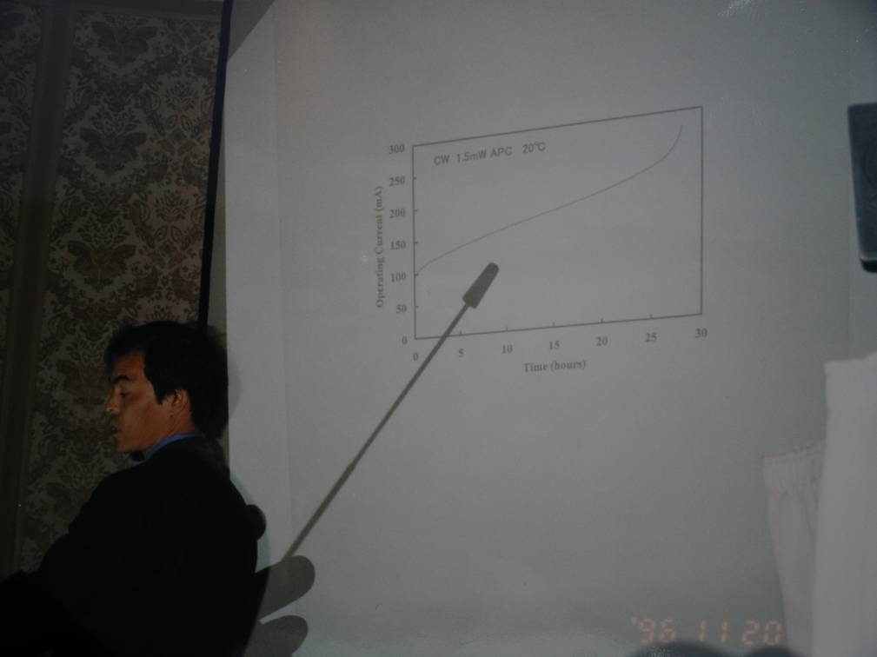
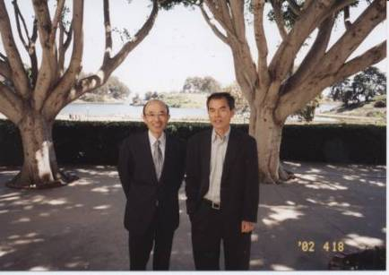
He enjoying UCSB life
Big Discovery !
Drive Current
keeping Constant Power-output
InGaN LD
20 hrs
Blue LD was Born by S. Nakamura
LEOS Annual Meeting, Nov. 1996, SFO
Nobel Prize in Physics (Eminent Engineer !)
“In” was key (patent, NTT, 1988)

Slide 24
History of LD
Direct Modulation of LD (my Doctor thesis , 1967)
  “Up to 400 MHz “(1975, ECOC)
Room Temperature CW operation at short-wave length(Bell Lab, 1970)
Shift to long-wave length, since Fiber loss minimum
  Low connection loss by fusion (NTT,1976) , Mono-mode fiber could promising (ECOC ‘76)
Mode-partition noise(NTT,1975)
  Answer to “How degree single-mode oscillation under direct-modulation is necessary?”
  VICSEL could be answer, but Implementation ? Larry did !
Decided to use DFB LD(NTT,1982)
  Fabry-Perot to Grating-index
  “Ikegami became crazy, it’s just toy”
Competition of Transmission Capacity
Reliability; “Hard screening method”, leaved from Activation-energy theory(NTT,1985)
WDM (Bell Lab)
We enjoyed competition without Optical-amplifier(pumped by LD) / LDA which overcome penalty of functions (~ 1995) !!
INTERNET Society (1998~ )
Laser is widely used in our life, CD, Projection Mapping etc.
PIC is common technology in optical NWing and will be common technology in Robotics/AI era

Slide 25
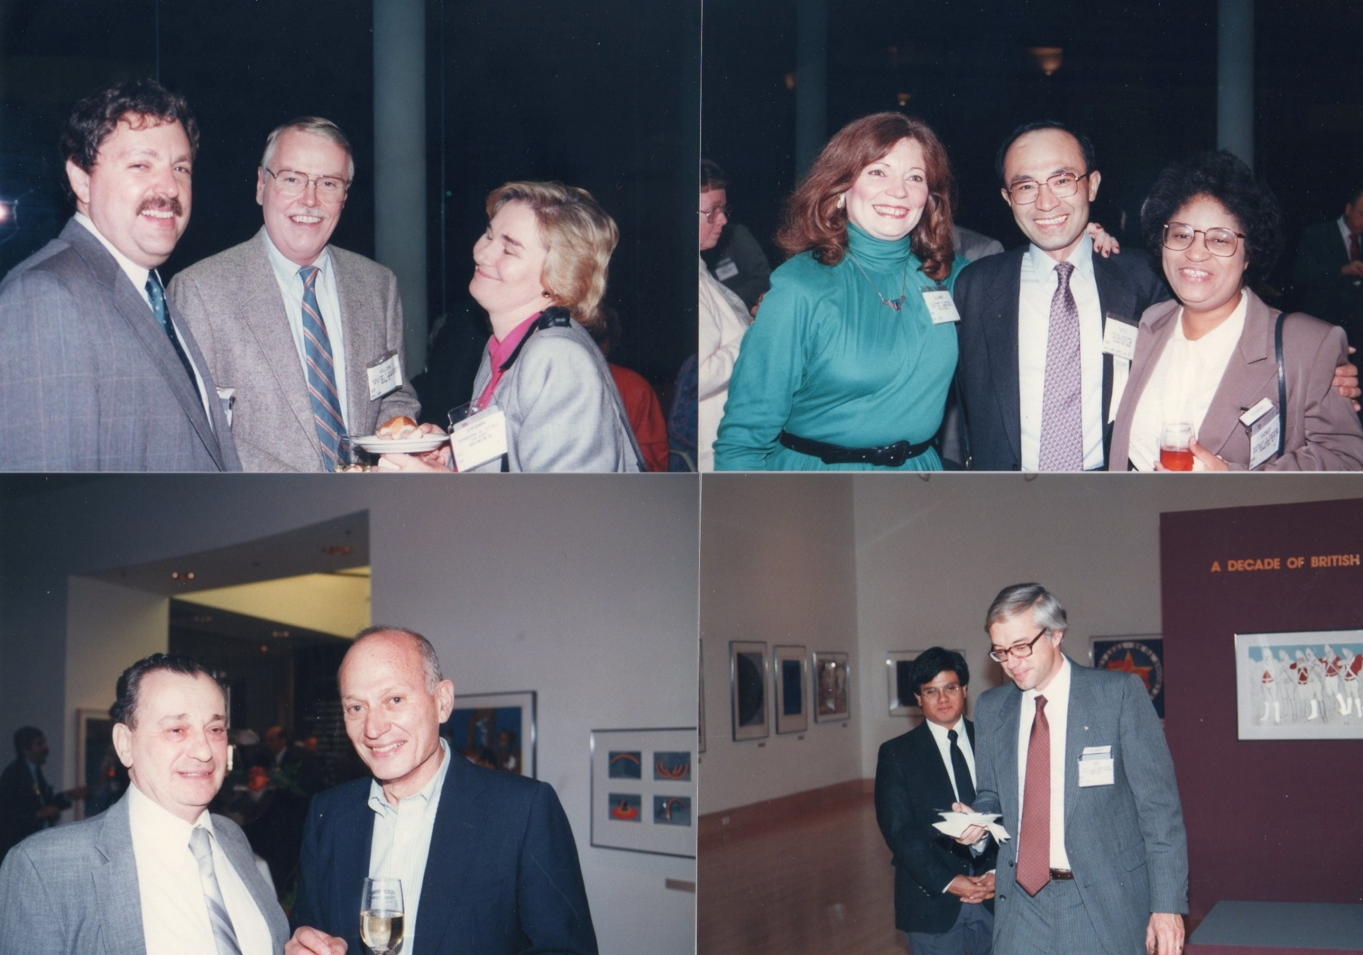
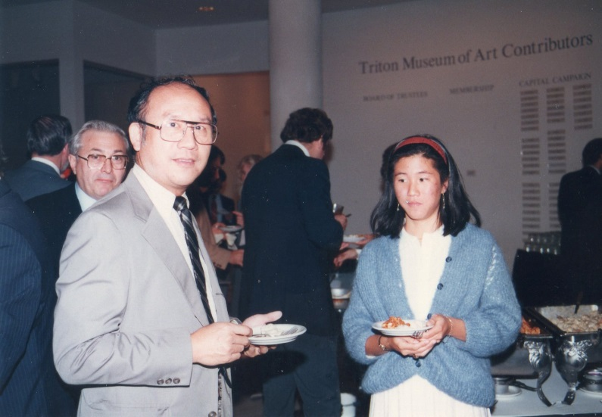
Once Upon a Time,,

Slide 26
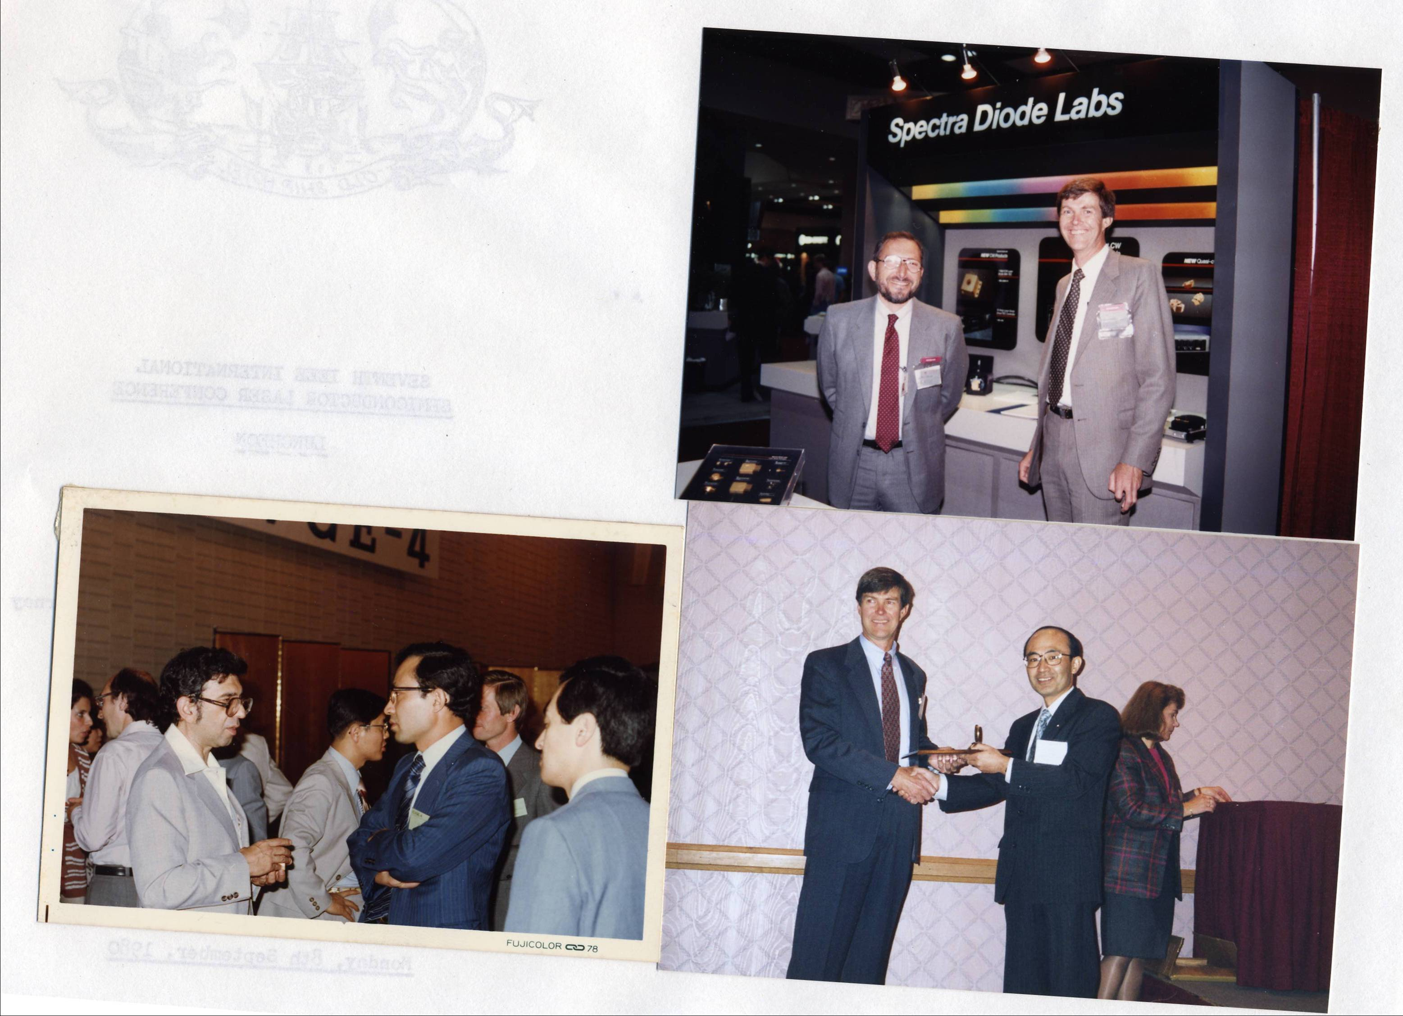
Don Scifres; good business with
High-power LD not Communication LD
Morton Panish
Room Temperature CW operation ‘70 with Hayashi
but not be appreciated
Received KYOTO Award (’01)

Slide 27
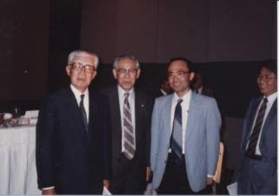
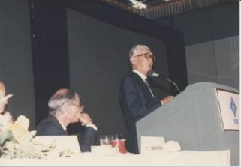
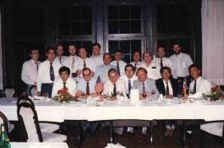
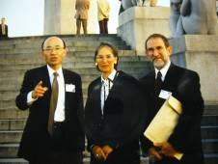
My International Activities
IEEE Fellow授与式(1986)
Japan was very, very far from East/West World
up to ’90s
Ibuka Prize
for consumer electronics
Appliance (1986)
Ibuka, Sony
IEC Meeting
Attended ECOC, London (1975)
’80’s Int. Standardization Activity, Convener of IEC/TC48 EU Project ECOC
Chair EU-DG13
’86 IEEE Fellow, joined Professional Society, America
IEEE/LEOS
Convener IEC/TC48

Slide 28
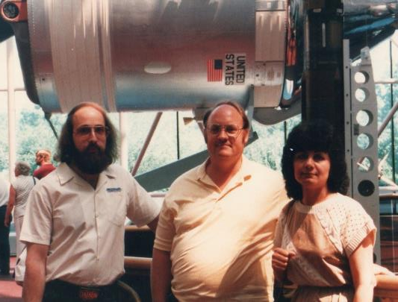
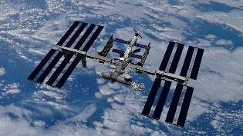
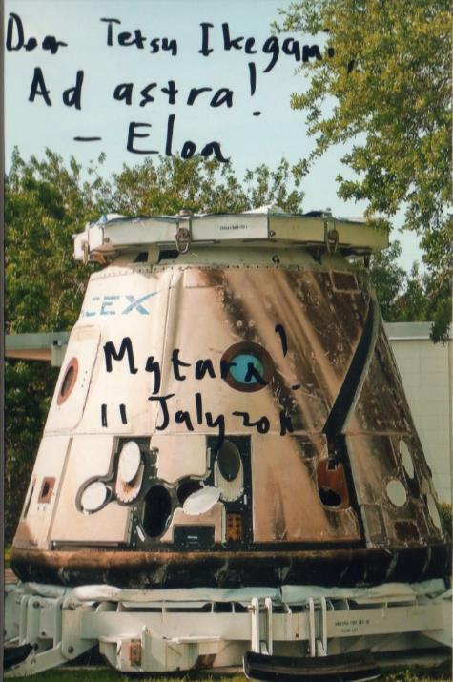
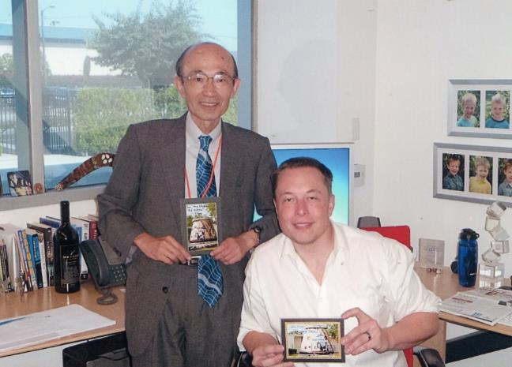
From LD to “Mission to Mars”
Visit Kennedy Space Center
Lunching “Galileo” (OFC 89)
JAXA
Chair
Japanese Space Activities Commission (’07)
After Last Lunching of Space Shuttle 136, Visited Elon Musk (11 July, ‘11)
Space X / Tesla

Slide 29
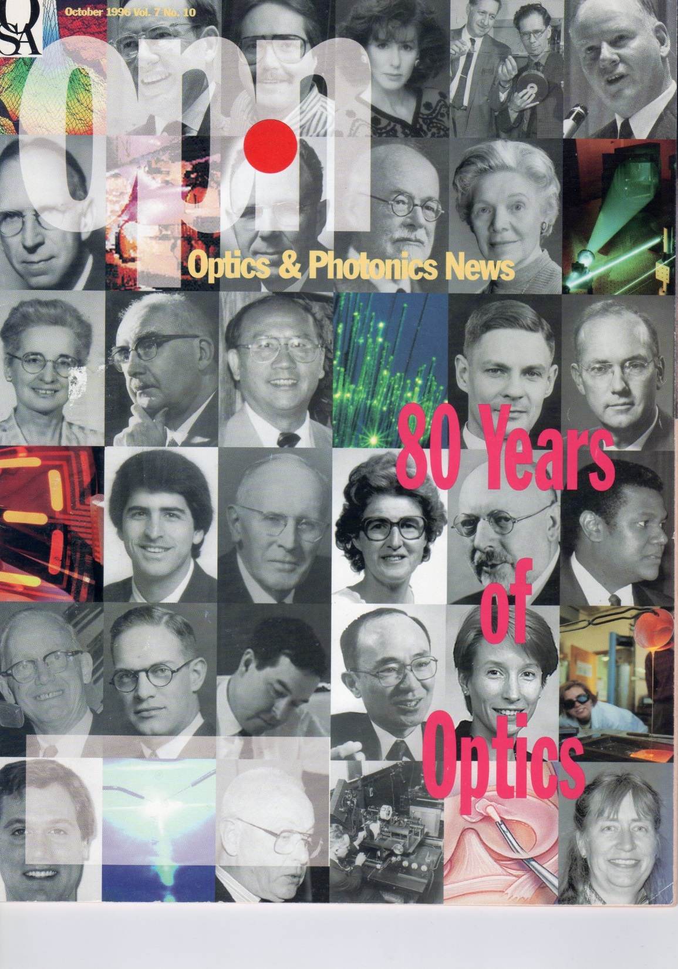
Optics & Photonics News (1995)
“80 Years of Optics”
What will happen, Tomorrow ?

Slide 30

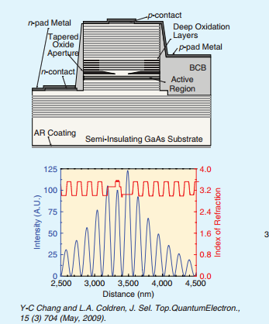
Congratulation, Larry !
Per aspera ad astra !
(Under Aging, Enjoy Happy Life !)
VCSEL
PIC

