Slide 1
Tribute to Prof Larry Coldren for all the great collaborations with the MOCVD Lab
Steven DenBaars
Materials and ECE Departments
Solid State Lighting and Energy Electronics Center
University of California, Santa Barbara

Slide 2
Optoelectronic Technology Center-1991
Prof. Larry Coldren and John Bowers PIs
hire DenBaars as Assistant Prof. and
help purchase 1st UCSB MOCVD system
Thanks for my 1st MOCVD System
Lasted 15 years & 500 papers!

Slide 3
Over 160 Joint Publications with Larry Coldren: PICs and also Nitride Lasers
Highly Cited & Key Papers
Indium tin oxide contacts to gallium nitride optoelectronic devices
T. Margalith, M Hansen, SP DenBaars, LA Coldren - Applied Physics …, 1999 - aip.scitation.org
Cited by 257 -→(Used by Cree, Lumileds, and others)
Widely tunable sampled grating DBR laser with integrated electroabsorption modulator
B. Mason, GA Fish, SP DenBaars, LA Coldren - IEEE Photonics …, 1999 - ieeexplore.ieee.org
Cited by 207 →(Coldren group spin-outs into Agility Communications)
Design of sampled grating DBR lasers with integrated semiconductor optical amplifiers
…, GA Fish, LA Coldren, SP DenBaars - IEEE Photonics …, 2000 - ieeexplore.ieee.org
Cited by 151
Measured and calculated radiative lifetime and optical absorption of quantum structures
…, E Zolotoyabko, AC Abare, SP Denbaars, LA Coldren - Physical Review B, 2000 - APS
Cited by 147

Slide 4
Coldren and DenBaars Group collaborated broadly in MOCVD of InP PICs
Numerous joint PhD students developed MOCVD technology for tunable lasers and
SG-DBR laser:
G, Fish, B. Mason, E. Skogen, J. Raring, J. Klamkin, J. Barton,
M. Mashanovitch, M. Heimbuch, V. Jayaraman et al.

Slide 5
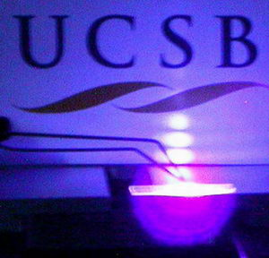
Did you know Larry Coldren also contributed to first GaN Blue Laser at UCSB 1997?
Characteristics of indium-gallium-nitride multiple-quantum-well blue laser diodes grown by MOCVD
J. Bowers, UK Mishra, L Coldren, S DenBaars - … Internet Journal of …, 1997 - Abstract Room temperature (RT) pulsed operation of blue (420 nm) nitride based multi-quantum well (MQW) laser diodes grown on c-plane sapphire substrates with lifetimes exceeding 6 hours have been demonstrated. Cited by 127 (joint GaN students, A. Abare, M. Mack, T. Margalith)

Slide 6
Thanks for your support Larry!

