Slide 1
Larry Coldren Symposium
Leif Johansson
Freedom Photonics
03/16/2018

Slide 2
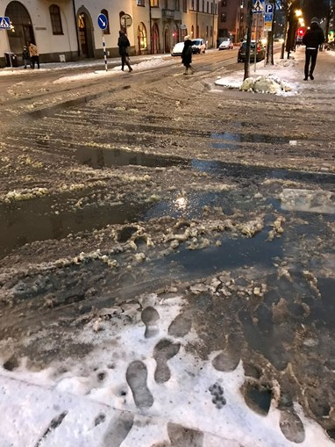
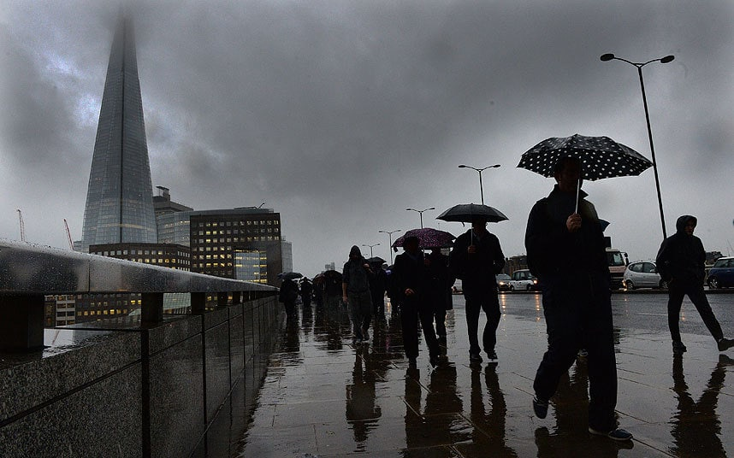
My Background
MSc Engineering Physics, 1997
KTH, Stockholm Sweden
PhD, EE 2002. University College London, UK

Slide 3

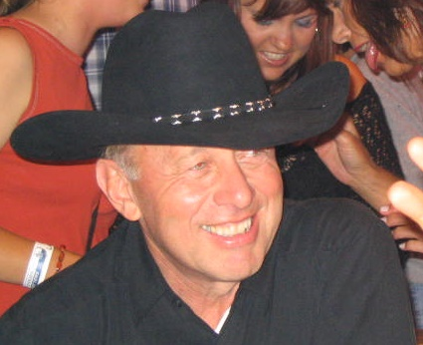
Joined Coldren group as Post-Doc in 2002
-working with Larry since that

Slide 4
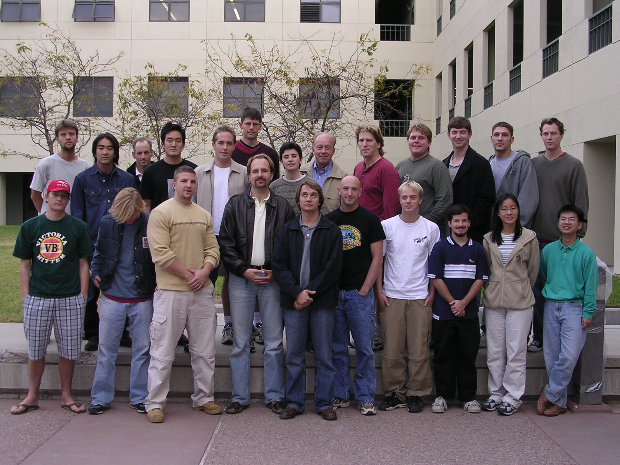
Larry Coldren Group Photo 2002

Slide 5
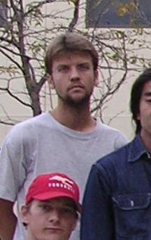
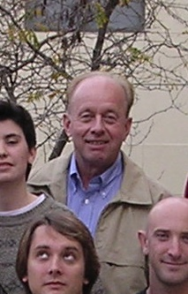
Larry Coldren Group Photo 2002

Slide 6
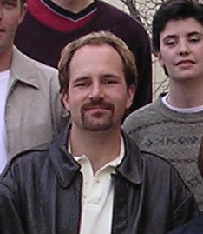
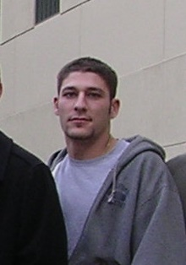
Larry Coldren Group Photo 2002

Slide 7
PICs for RF Photonics 2002 → …
Widely tunable RF Photonic Transmitters
Wavelength Converter PICs
Optical Phase-Locked Loops
Optical Comb Generators and RF Synthesis
Reconfigurable RF Filters
Optical Beam Steering
Integrated Phase Sensitive Amplifiers
Integrated Laser and Locker PIC
Many, many more PICs…..

Slide 8
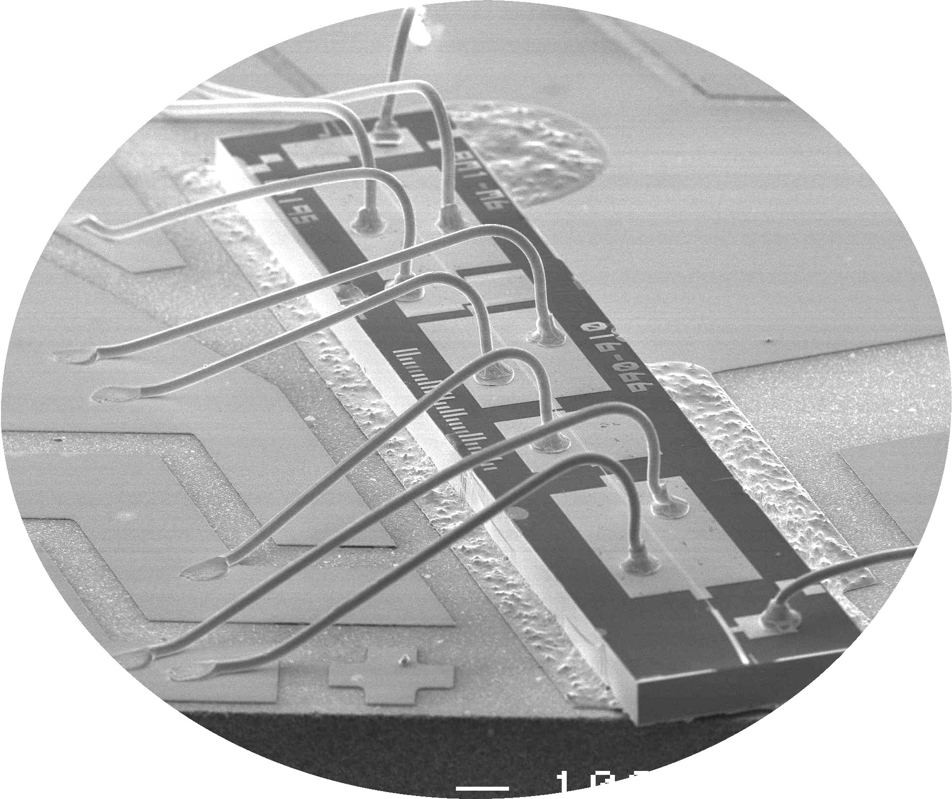
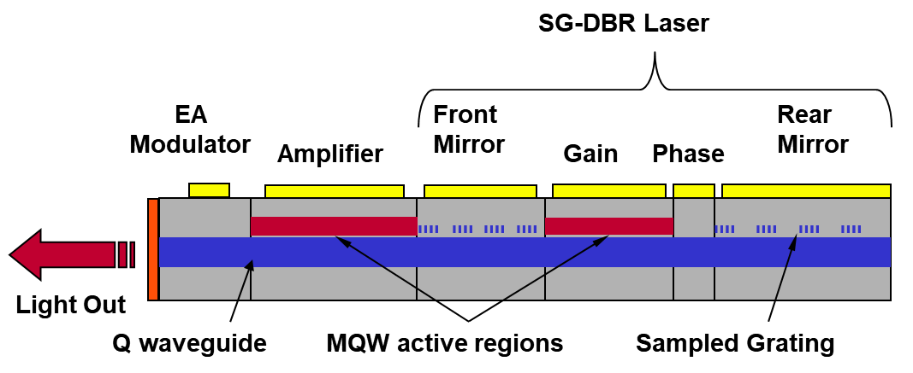
Photonic Transmitters
UCSB
  RFLICS: Integrated RF Photonic Transmitters
  CS-WDM: Wavelength Converters
Agility
  CS-WDM: Integrated RF Photonic Transmitters

Slide 9
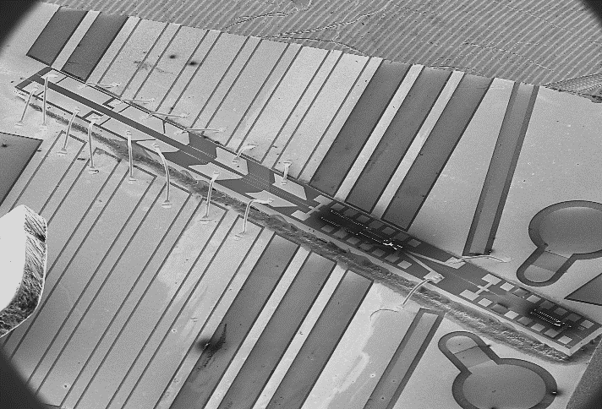
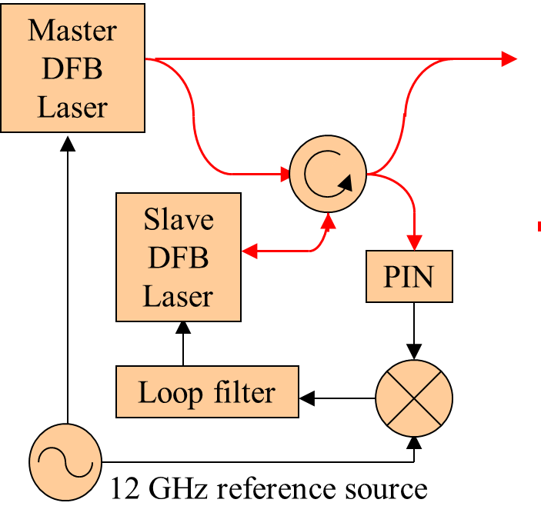
Optical Phase Locked Loops (2006 – 2014)
University College London
  Alwyn Seeds
  Fiber based Optical Injection Locked Loop
UCSB
  Larry – Photonic Integration
  OPLL: Small size, low latency, fast

Slide 10
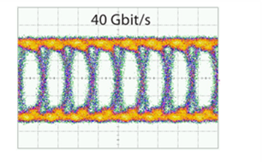
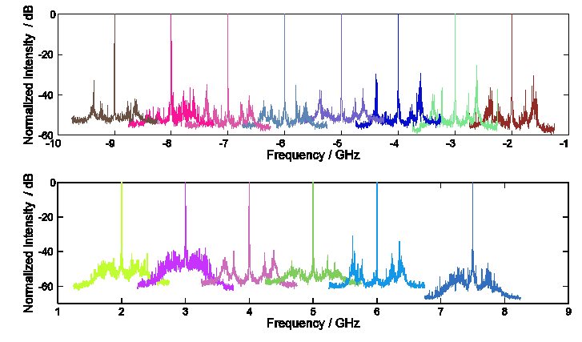
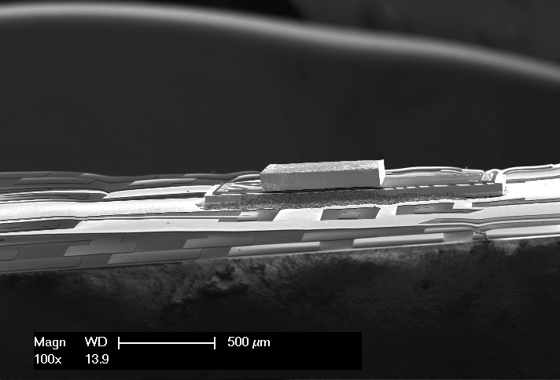
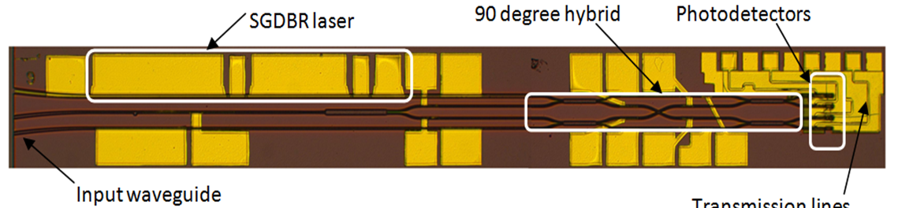
Optical Phase Locked Loops (2006 – 2014)
DARPA PHOR-FRONT
  RF Photonic tracking receiver OPLL
  Minimize latency: 10 ps target
  Flip-chip integration: PIC-IC
DARPA PICO program
  OPLL Receiver
  40 Gbaud PSK OPLL
  Tunable offset locking

Slide 11
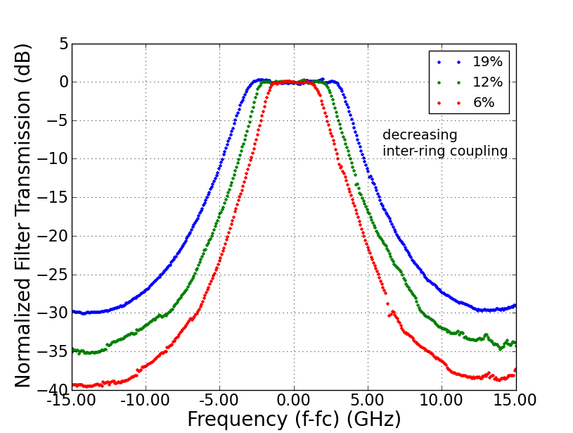
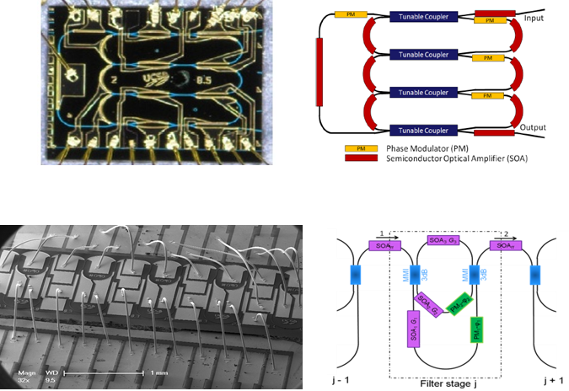
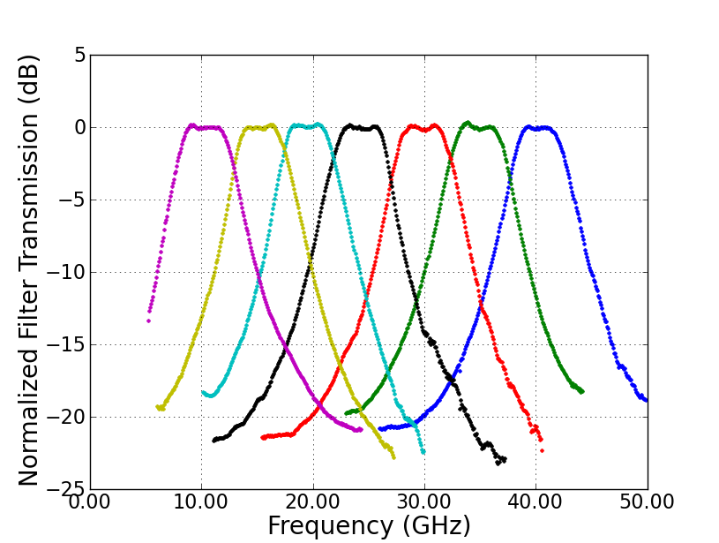
Programmable Optical Filters (PHASOR)

Slide 12
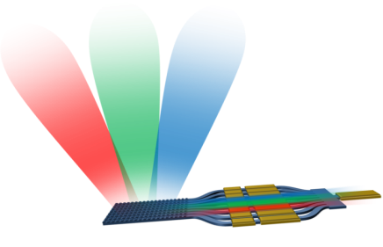
Optical Beam Steering (DARPA SWEEPER, 2014)
SWEEPER: Optical Phased Array
  4 teams – 3 used NxN phase control
  → Larry: “Use grating and tunable laser”
  → N+1 control
DARPA MOABB (2017)
  → 3 teams – All use N+1 Architecture

