Slide 1
Tribute to Larry Coldren:
Mentor, Colleague, Friend
Jonathan Klamkin
Electrical and Computer Engineering Department
University of California Santa Barbara
klamkin@ece.ucsb.edu

Slide 2
My History with Larry
I met Larry in early 2002 when I visited him at UCSB and then subsequently joined his group.
Spent 6 years with him as a PhD student
We kept in touch and collaborated in various ways during my ~7 years at various places (MIT Lincoln Laboratory, Scuola Sant’Anna Pisa, Boston University).
  Even well after I graduated from UCSB he was extremely supportive with career advice, reference letters, guidance
In 2015 I joined UCSB as a faculty member
  Working closely with Larry on various programs and under the affiliation of the OTC

Slide 3
Selected Projects and Impact

Slide 4
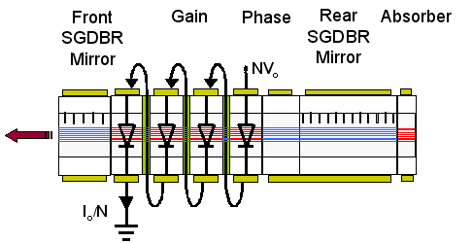
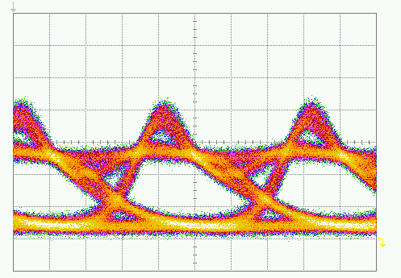
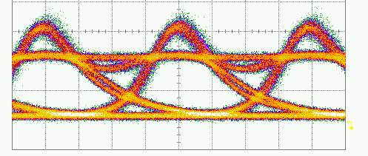
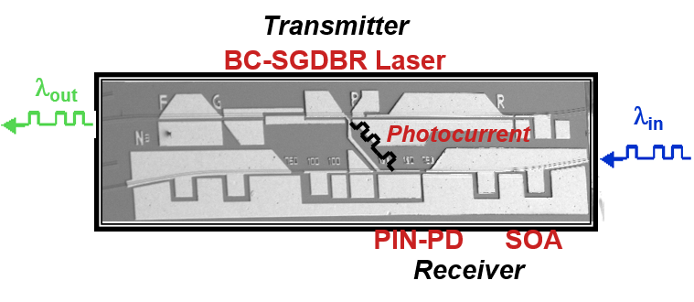
Bipolar Cascade Lasers and Photocurrent Driven Wavelength Converters
Gain section segmented into electrically isolated sections, connected in series
Scaling of differential efficiency and inherent 50-Ω matching
Photocurrent driven wavelength conversion with conversion gain
1-stage
3-stage
Differential Efficiency Scaling
I_{bias} = 70 mA V_{p-p} = 1.49V ER = 8.0 dB
I_{bias} = 24 mA V_{p-p} = 0.65 V ER = 9.6 dB
Low power penalty wavelength conversion
Chip conversion gain
Photocurrent Driven Wavelength Converter
*Under DARPA RFLICS and CSWDM

Slide 5
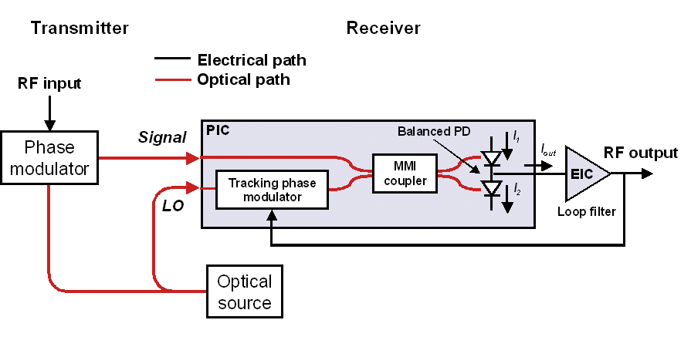
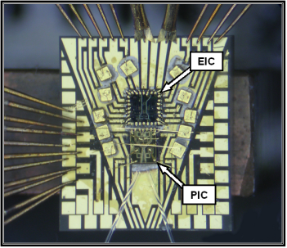
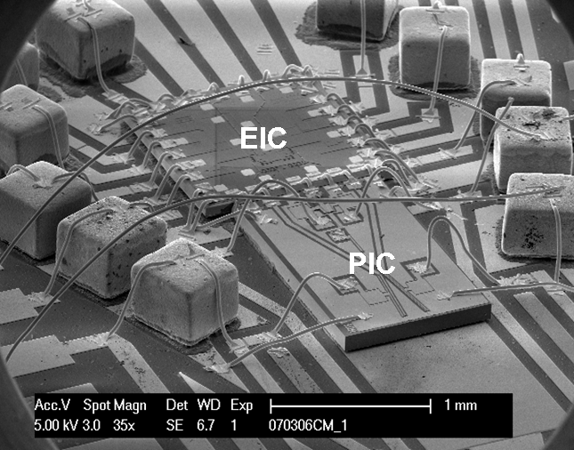
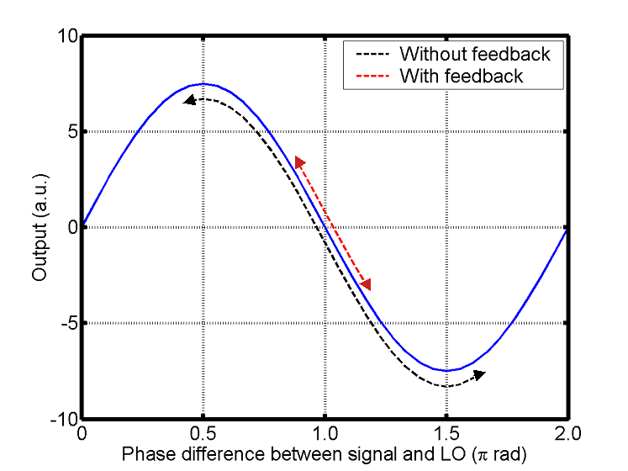
Integrated OPLL for Linear Phase Demodulation
Phase modulation inherently linear and not limited to 100% modulation depth
Coherent receiver with feedback for close tracking of received signal
  More linear operation for high dynamic range
  Frequency range limited by loop delay → integration
Coherent Receiver with Feedback
Receiver Response
SFDR = 125 dB·Hz^{2/3} for f_{signal} = 300 MHz
+14 dB improvement with feedback
Phase detection up to 1 GHz
Loop gain = 2i_{o} Z_{PD} g_{m} π/V_{π} Z_{PD} e^{-j2πfτ}
*Under DARPA PHORFRONT program

Slide 6
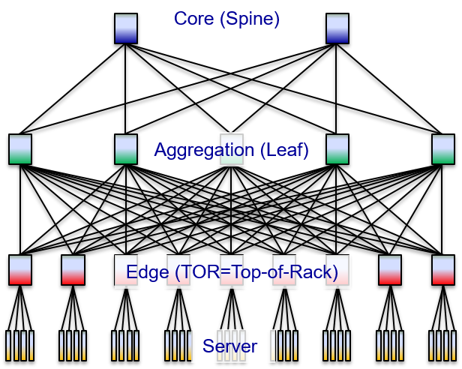
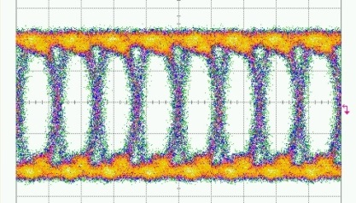
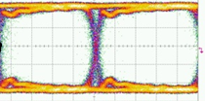
Analog Coherent and Energy Efficient Transceivers
Integrated OPLL coherent receiver
Analog coherent links for improved sensitivity → energy efficient interconnects
Electronic-photonic integration and integration with switch package
Flip chip packaging and WDM multi-channel scaling
Low power coherent for data centers
100 kHz SGDBR reference laser
>1 GHz loop bandwidth
<10 ns phase locking
Error free up to 35 Gb/s
40 Gb/s
back-to-back
10 Gb/s
25 km SMF
1. S. Ristic et. al., JLT (2010)
2. M. Lu et. al., Optics Express, (2012)
3. P. R. A. Binetti et. al., JQE (2012)
4. M. Lu et. al., JLT (2013)
*Under DARPA PICO and ARPA-E ENLITENED
*Figures from Schow, Coldren

Slide 7
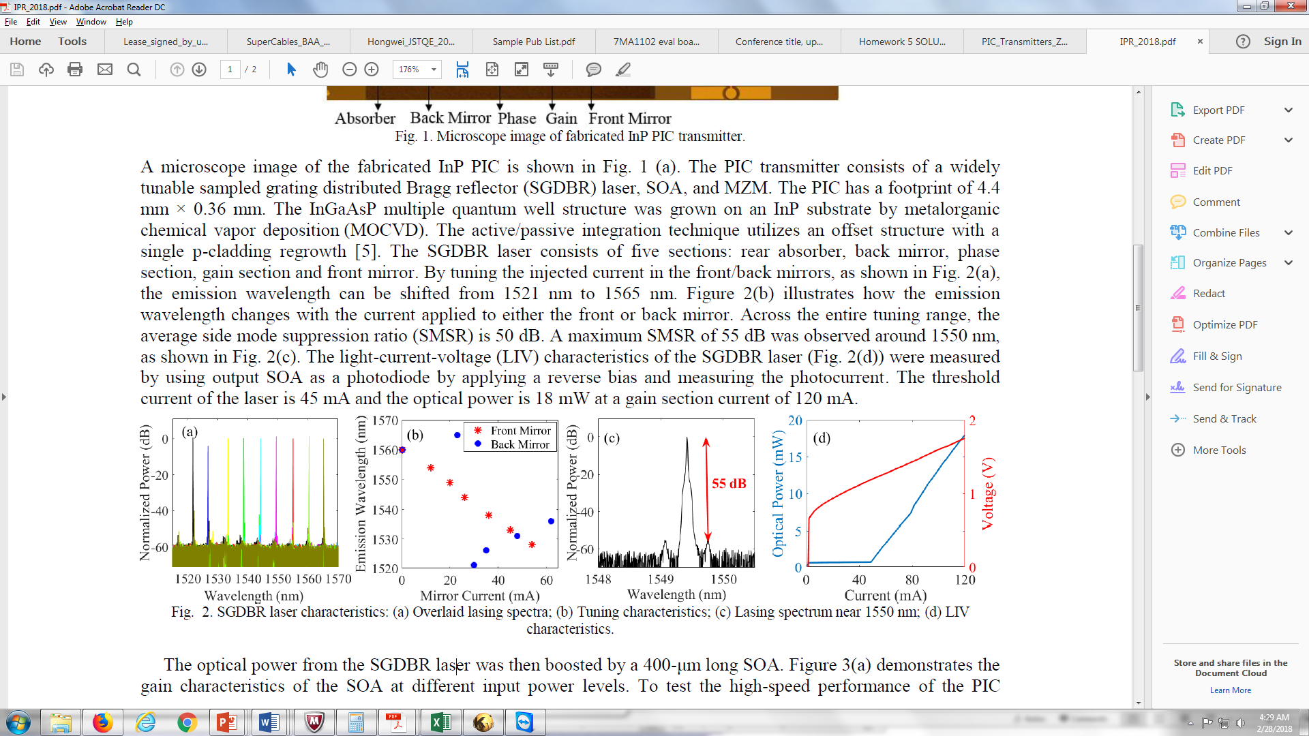
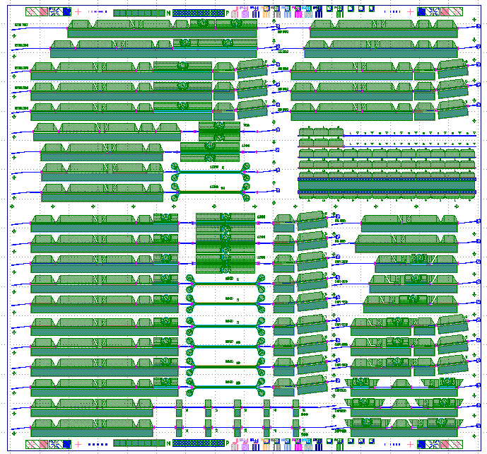
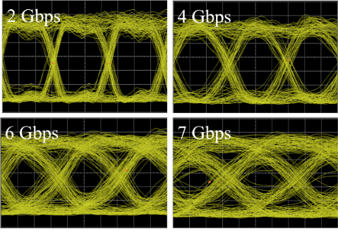
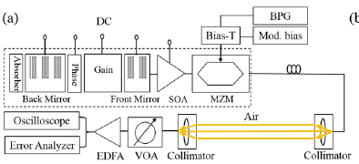
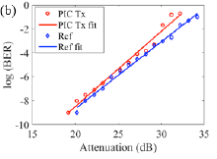
Free Space PIC Transmitter
Sampled Grating DBR (SGDBR) Laser TX
Layout
Fabricated device
>15 mW laser power (>60 mW with output SOA)
~45 nm tuning range; >50 dB SMSR
Up to 7 Gb/s modulation (50 Gb/s possible)
Free space link at 1 Gb/s demonstrated
  BER < 1e-9 for ~20 dB attenuation (120 m distance)
  < 1 dB power penalty compared to 10 Gb/s LN modulator
Free space link performance
*Developed under NASA FSOC program

Slide 8
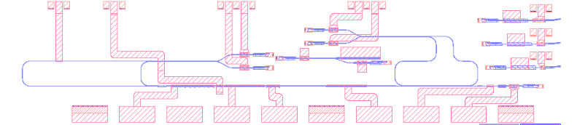
SGDBR Laser with Integrated λ Locker
SGDBR laser with asymmetric MZI on backend for wavelength locking
Open loop tune SGDBR laser to within ±15 GHz of desired frequency
Circuit captures and locks to zero crossing of asymmetric MZI filter
Stepping back mirror (BM) and sweeping phase section current
Phase
Locker PDs
Receiver
Locker AMZI
Output/emitter
Back
Mirror
Gain
Front
Mirror
SOA
*Developed under DARPA MOABB program

Slide 9
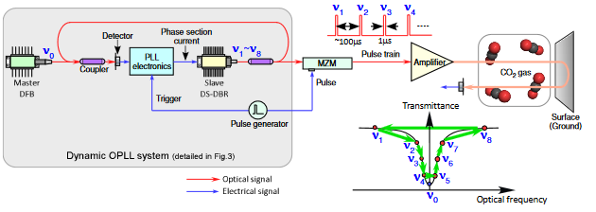
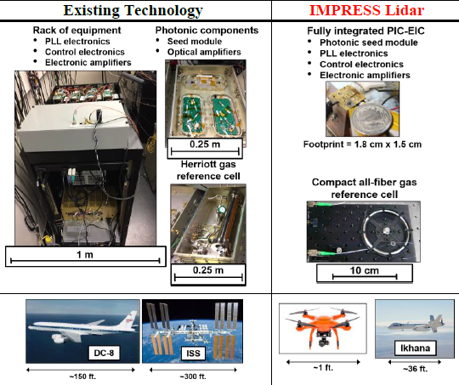
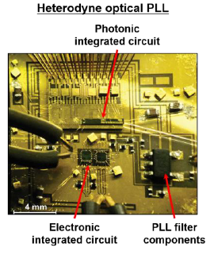
Remote Sensing Lidar
Lidar for CO₂ Sensing
Fully integrated lidar sensor based on optical phase locked loop for fast switching/locking
K. Numata, et al., Optics Express, 2012 (NASA GSFC)
Integrated OPLL
Switch across 5.6 nm and locking within 200 ns
S. Arafin, et al., Optics Express, 2017 (Coldren, UCSB)
*with NASA Goddard Space Flight Center

Slide 10
Nicknames

Slide 11
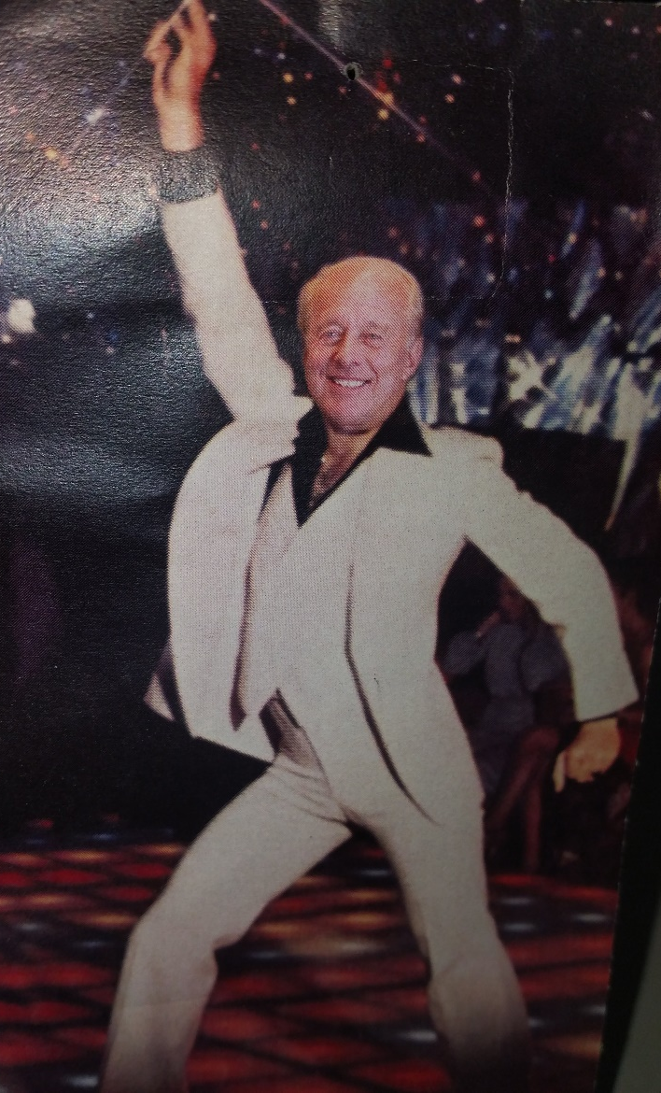
Larry Cooldren

Slide 12
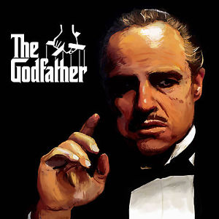
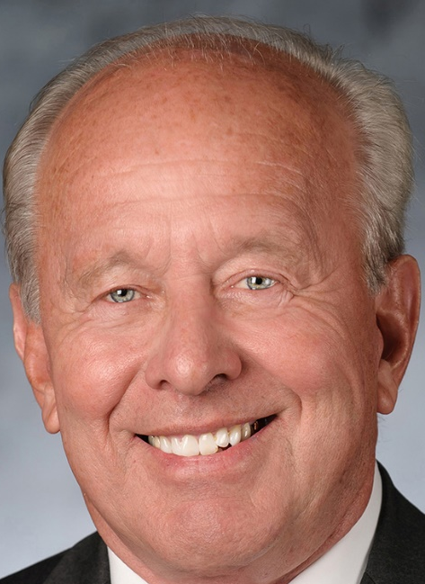
Larry Coldreone

Slide 13
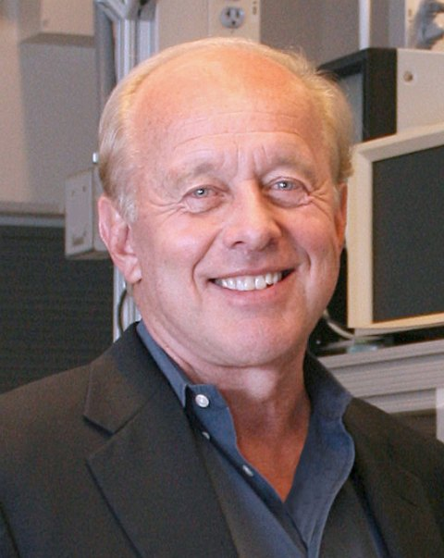
The Big L

Slide 14
Closing Thoughts

Slide 15
Thoughts
Stories about his life
  Growing up in Pennsylvania
  Did you know Larry was at the Wilt Chamberlin 100 point game?
  Stories about Stanford, Bell Labs, Agility, …
  Stories about his family and especially his sons
“Academic father”
Just a few of his words make a huge impact on lots of people
Please keep doing what you are doing

