Slide 1
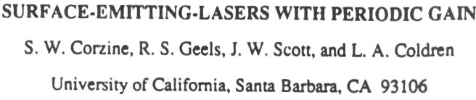
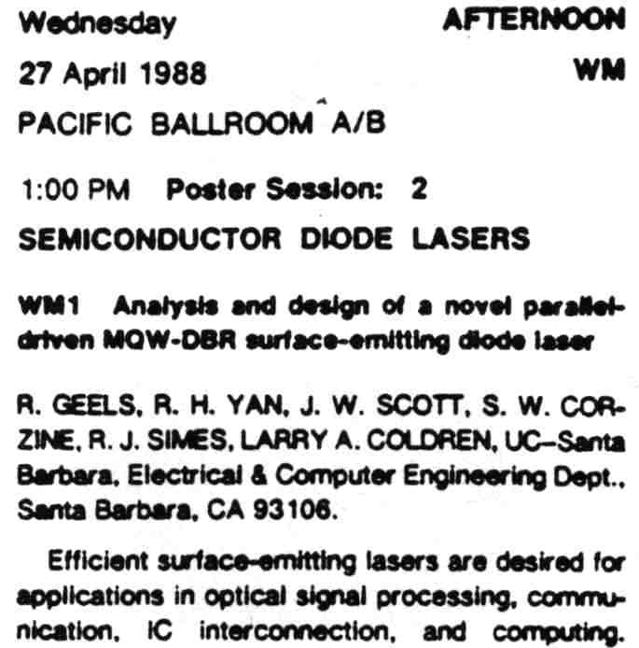
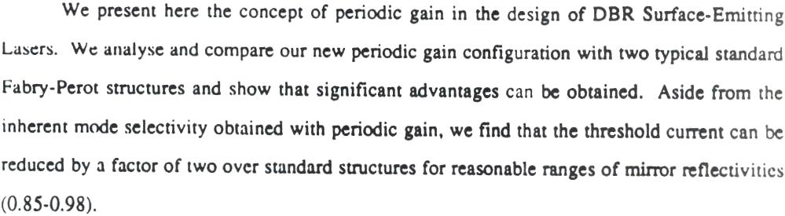
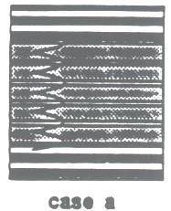
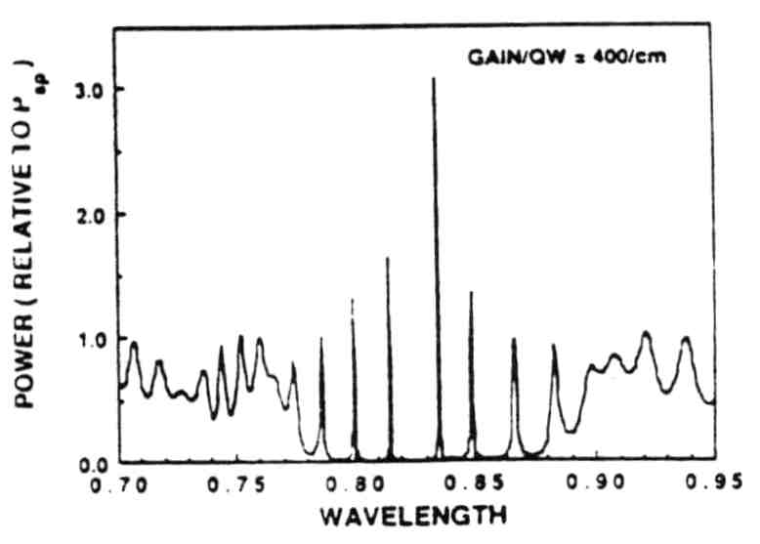
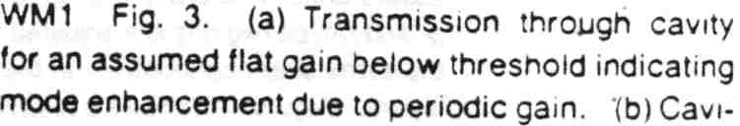
UCSB - Periodic gain

Slide 2
VCSEL Active Region (R)Evolution
Experimental diodes only; post-1989 → like edge-emitters’
Really 220um
Mid-1989
Melngailis
Ogura (DFB)
Wang group
Koyama (RT-CW)
Iga
Origin of
VCSEL
Iga group
Botez
Jewell
Lee/Jewell
100 Å
Post 1989 - NO LOOKING BACK!

Slide 3
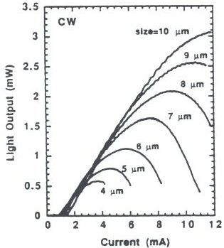
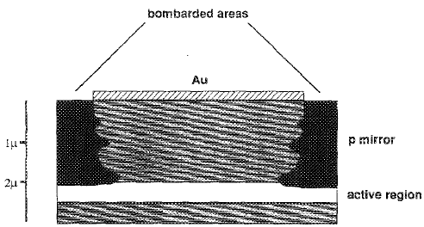
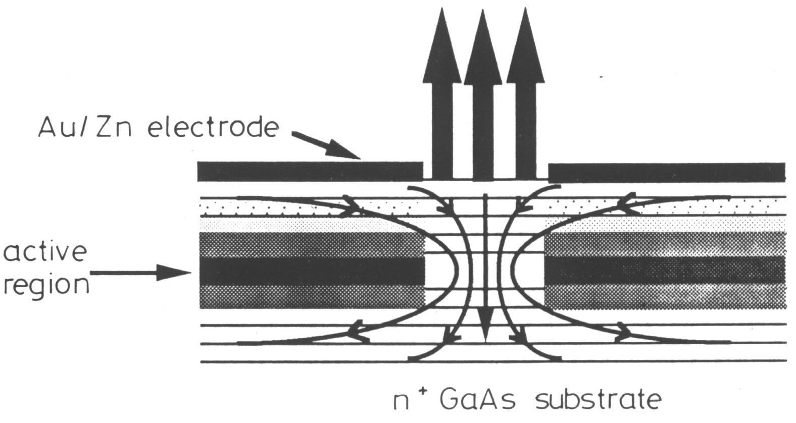
Important Innovations
These advances enabled Gigabit Ethernet VCSELs
Ion-Implanted Planar VCSEL
(heat diss., manufacturable)
1989
Bell Labs (MH) Bellcore
Top-emitting 850nm
(commercial architecture)
1990
Bell Labs (HL)
Large-scale reliability study/development and manufacturing
early 1990’s
Honeywell
Gain Offset for Temp Stability;
Gain/Power Optimization
1990
University of California Santa Barbara

Slide 4
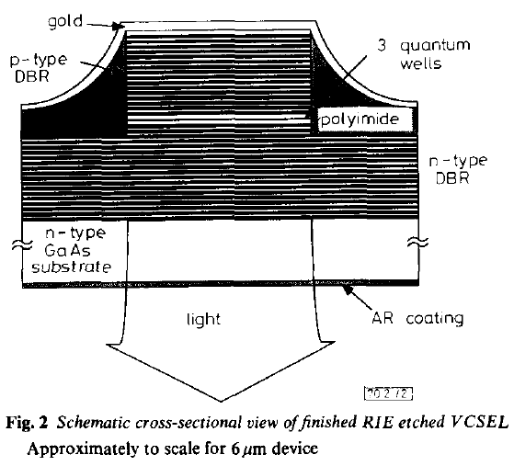
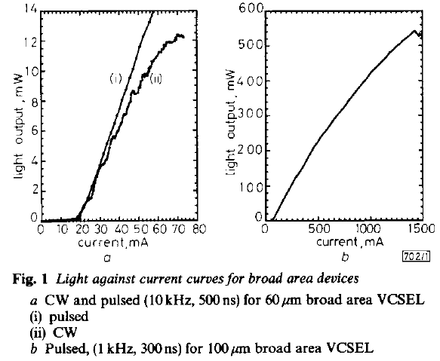
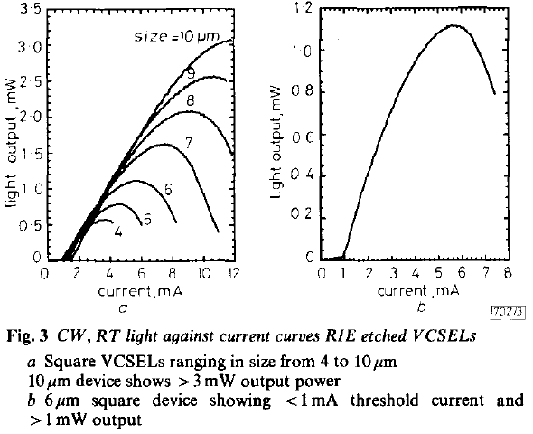
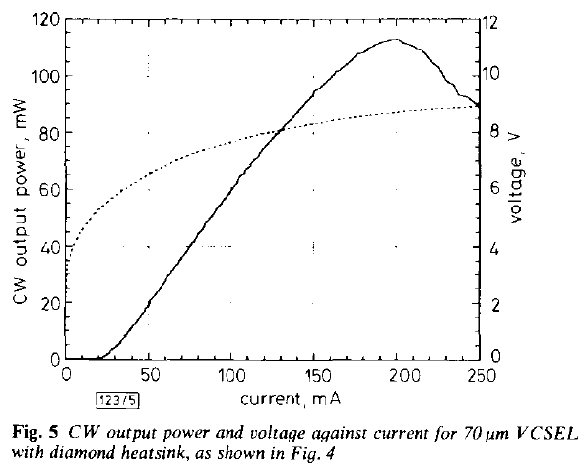
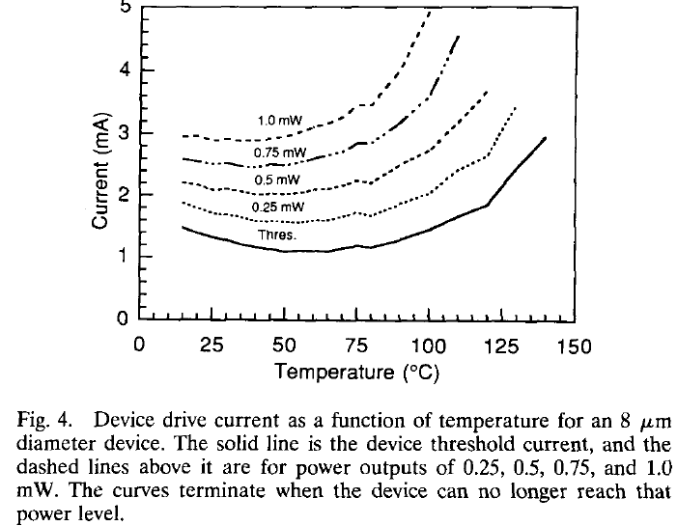
Excellent MBE (+ inventions: gain at anti-nodes, novel mirrors)
Enabled Record Performance VCSELs (’90 – ’95)
R. S. Geels & L. A. Coldren, Electron. Letts.,vol 27, no. 21, Oct., 1991
>12 mW - CW
Pulsed
>1 mW – CW
<1 mA – I_{th}
Lowest threshold/highest power
F. H. Peters, et al, Electron. Letts., vol. 29, no. 2, Jan., 1993
D. B. Young, et al, PTL, vol. 5, no. 2, Feb., 1993
~115 mW - CW
Record temperature stability
Highest CW power
Notes:
Top: 1991 publication showing first VCSEL result with < 1 mA threshold and > 1 mW out CW; also showed significant output powers for different sizes.
Bottom: 1993 publications showing record output powers; and novel ‘gain offset’ concept for providing near zero output power change vs. temperature.

