Slide 1
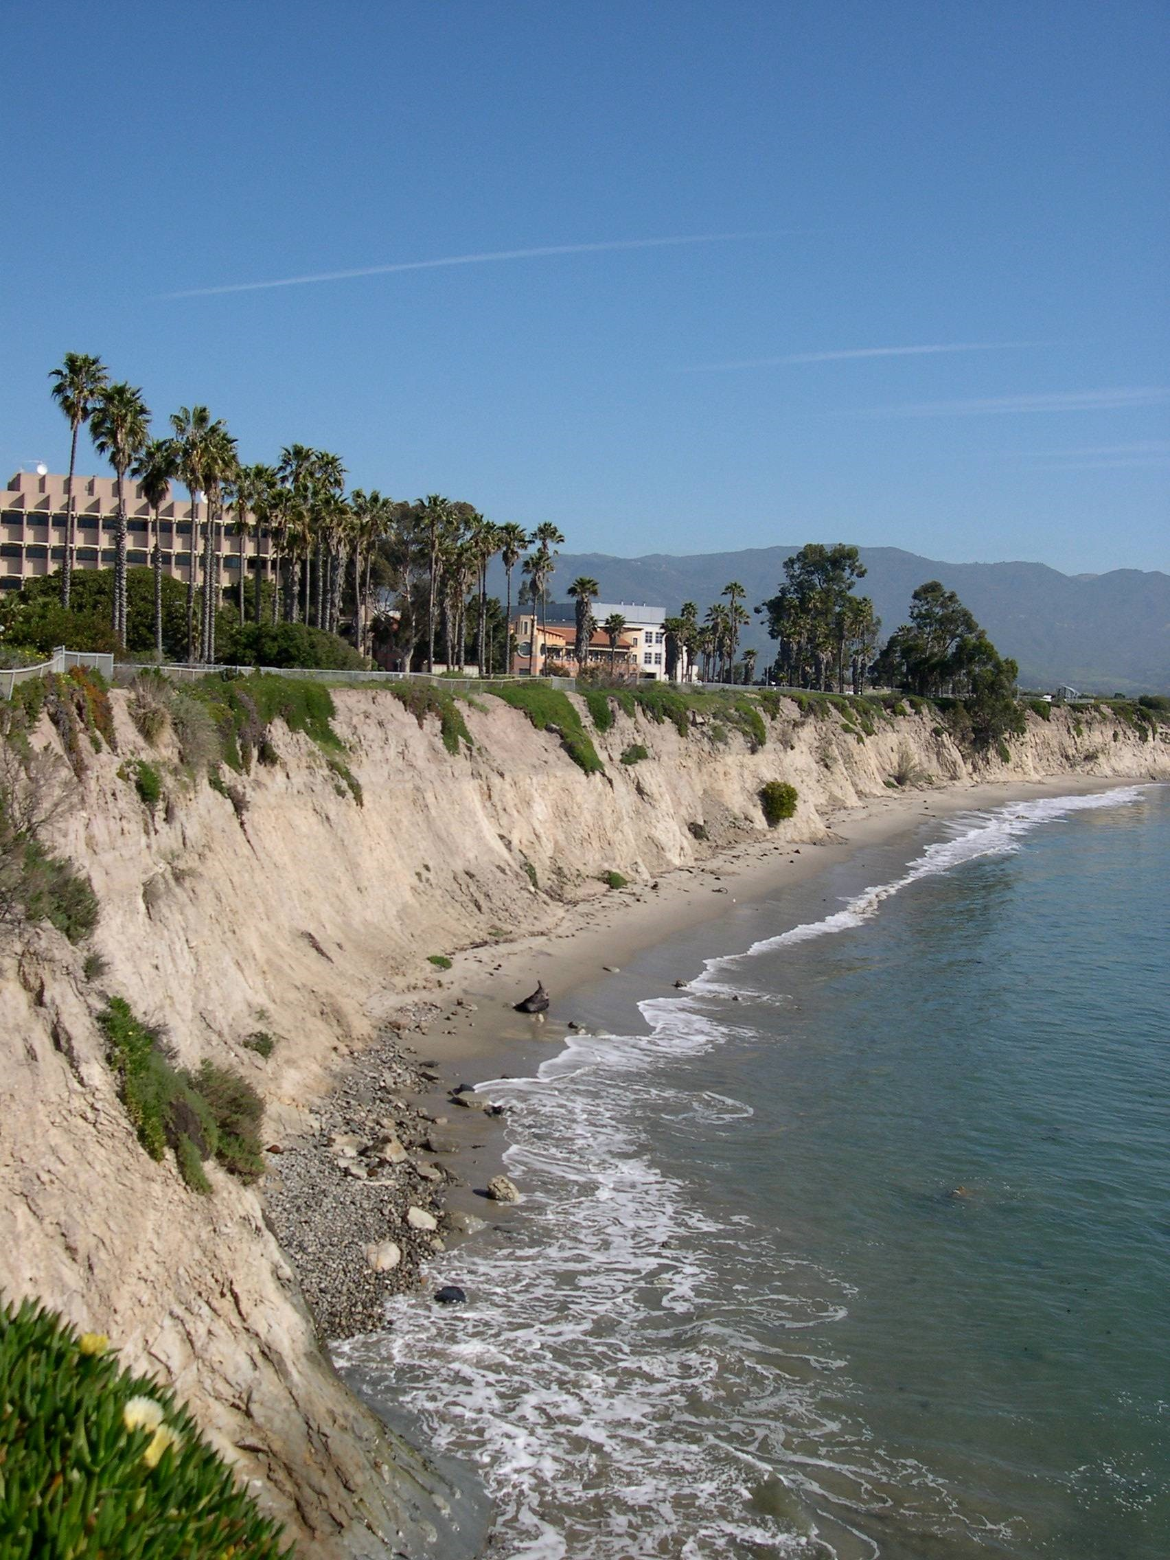
My years in the Coldren VCSEL group
  Brian Thibeault (and many others)
  1991-1997

Slide 2
A trip back to the past?
Fruitful time for VCSEL device research
Several groups working on device fundamentals
What were we working on then?

Slide 3
Bottom Emitting VCSELS in 1991
RIE Etched Post VCSELs, planarized
0.7mA threshold (smallest devices), >3mW output (larger devices)
Standing wave effects
Strained InGaAs QW gain calculations,
High doping/digital graded mirror interfaces.
Automated MBE growth.
Randy Geels, Scott Corzine, Jeff Scott, Larry Coldren, 1988-1991+

Slide 4
Improving Bottom Emitting VCSELs
Low Voltage mirrors using lower Al composition mirror layers, Low T Be doping to stop Be segregation, Band engineered linearly grade-delta-doped interfaces
Solid-source carbon doping
In-Situ Growth monitoring
Controlling Gain peak – Cavity mode offset for high temperature operation, better operation at higher temps.
Increased output powers, high temperature operation, wall plug efficiency near 20%
Matt Peters, Bruce Young, Scott Corzine, Jeff Scott, Brian Thibeault, Frank Peters, Art Gossard, Larry Coldren 1992-1994

Slide 5
Intra-Cavity Contacted VCSELs
First thin air-gap laterally etched “dielectric aperture” for current and optical confinement, sub-mA thresholds
Finite element device modeling foundation developed for uniform current spreading
dopant-free mirrors/substrate for on-wafer microwave testing,
1mW+ single mode power, 8.5GHz bandwidth.
Jeff Scott, Bruce Young, Scott Corzine, Brian Thibeault, Matt Peters, Frank Peters, Randy Geels, Larry Coldren, C .J. Mahon , M.L . M ajewski, 1991-1995

Slide 6
Oxide Aperture VCSELs – Improved Device Scaling
Understanding/measuring Optical Scattering Loss Limitations
Reduced Loss using thin apertures.
Low Threshold currents, <200 uA
Scalable DQE for 3um and larger apertures
2mW single mode
High Modulation Efficiency, > 15GHz at very low currents
Brian Thibeault, Phil Floyd, Eric Hegblom, R. Naone, Y. Akulova, Kent Bertilsson, Tim Strand, Scott Corzine, Jeff Scott, Larry Coldren 1995-1997+

Slide 7
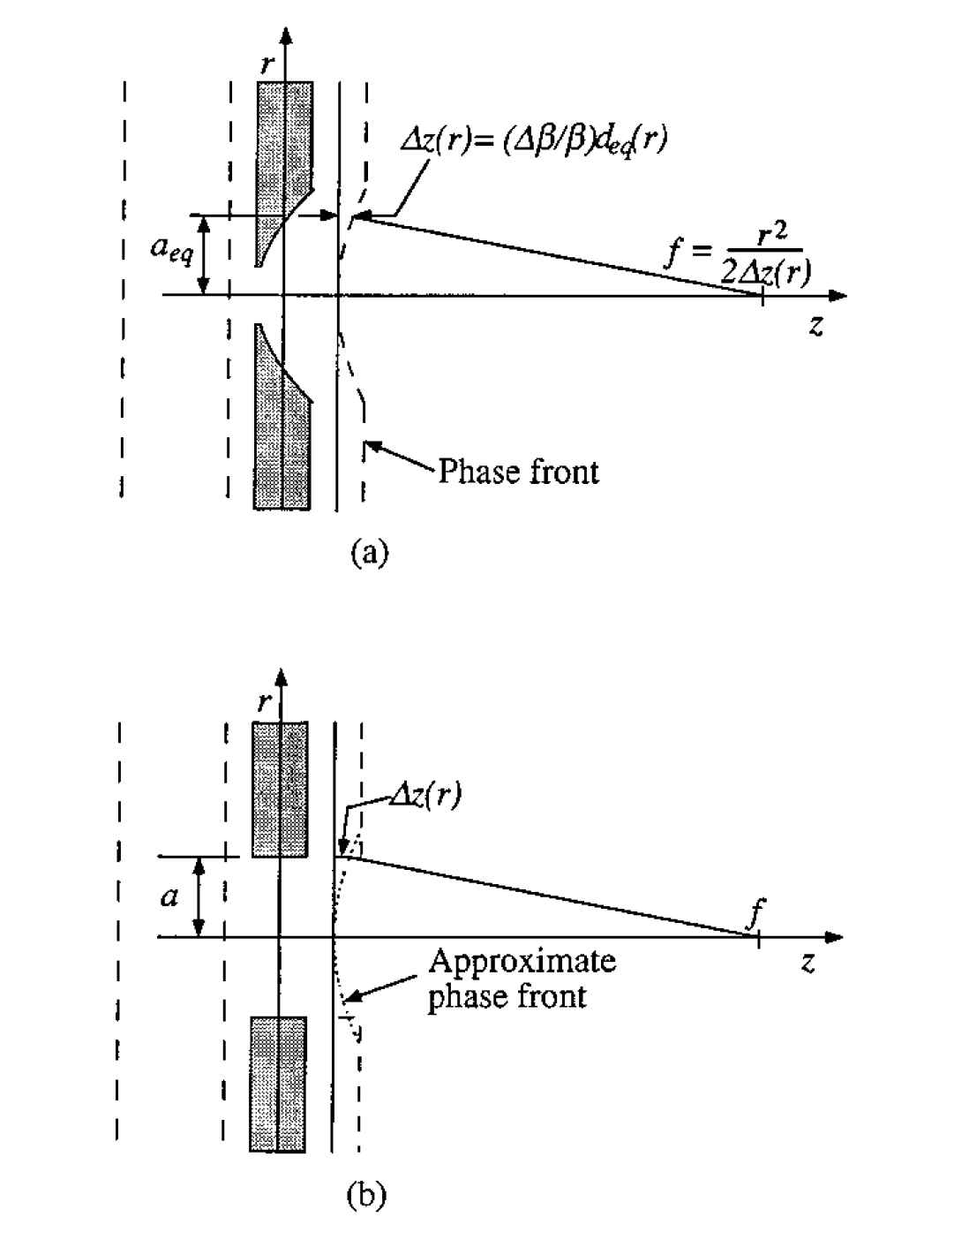
Aperture as a Lens - Tapered Aperture VCSELs
Further Scaling with Tapered Apertures.
Modeling of scattering losses in cavity
Low Threshold currents, <150 uA
High Efficiency, ~60% DQE for 1-2 um and larger apertures
Scaling rules for apertures
Eric Hegblom, R. Naone, Brian Thibeault, Phil Floyd, Y. Akulova, Dubravko Babic, Geoff Thompson, Jeff Scott, Larry Coldren 1995-1997+

Slide 8
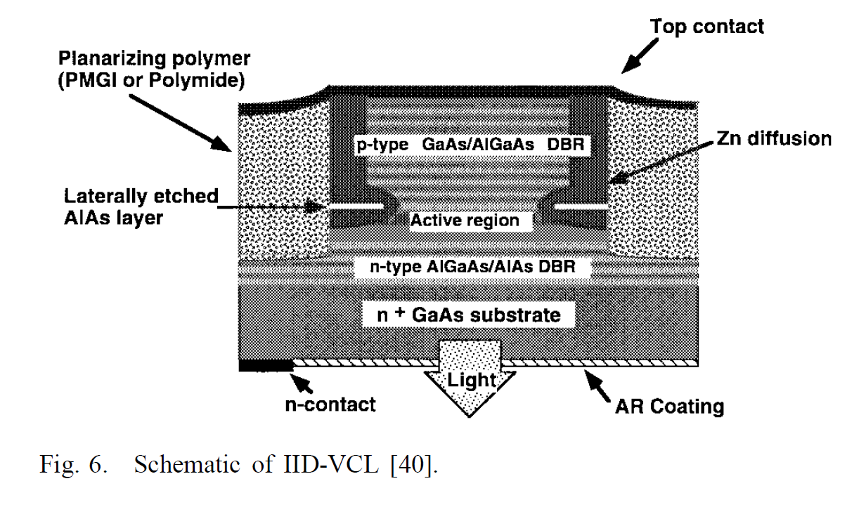
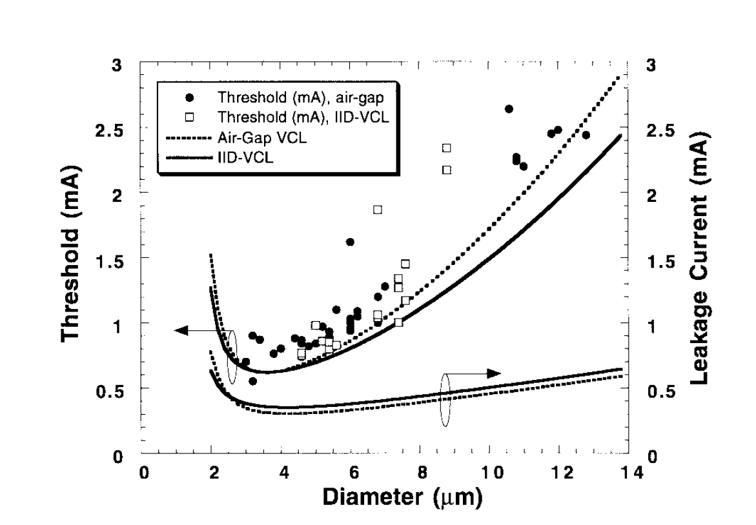
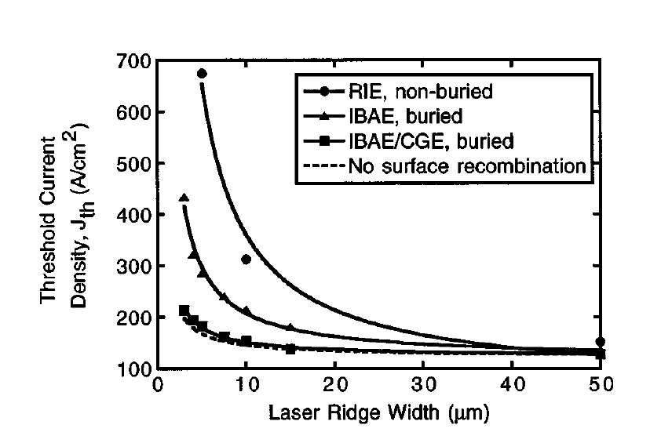
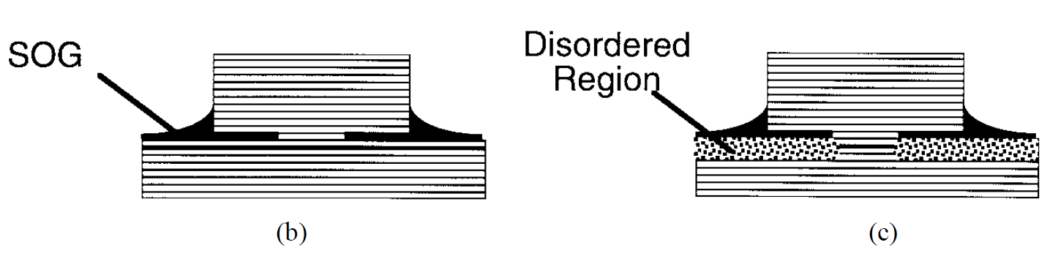
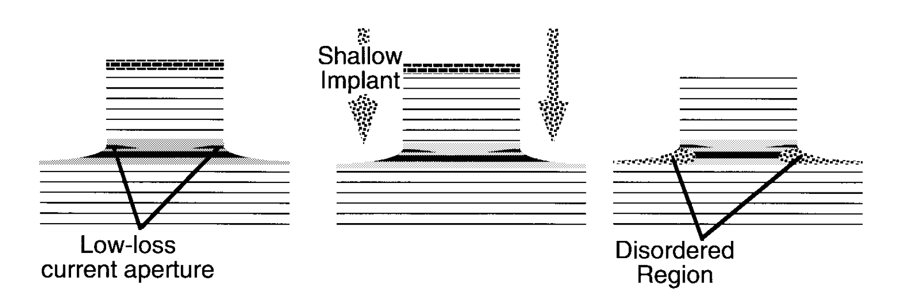
Carrier Leakage – Eliminate Diffusion/Surface Loss
Reduce Surface Recombination – In-Situ Etch/Regrowth
Surface passivation
Reducing diffusion - QW implant or diffusion plus annealing for impurity-induced disordering
Reduce Carrier diffusion – Segmented Quantum wells by selective area desorption
Quantum Dot lasers (this came later)
Ryan Naone, Tim Strand, David Mui, Bruce Young, Brian Thibeault, Phil Floyd, Eric Hegblom, Larry Coldren 1994-1997+

Slide 9
Heat Sinking and Spreading, 1D&2D arrays, Integrated Microlenses for Free Space Comm.
Au Plating to bury VCSEL and spread heat – reduced thermal resistance
  Facilitate flip-chip bonding
  Thermal resistance drops in half
Thermal crosstalk in 2-D arrays
Digital etching and regrowth for multi-wavelength 2-D arrays.
Integrated Microlensing on VCSEL arrays
Eva Strzelecka, Kent Bertilsson, Duane Louderback, Geoff Thompson, Torsten Wipiejewski, Matt Peters, Bruce Young, Brian Thibeault, Jack Ko, Gerry Robinson, Larry Coldren, Evelyn Hu 1994-1997+

Slide 10
Cryogenic VCSELs and Strained 850nm VCSELs
Intracavity contact designs. Low voltage rise at low temp.
60uA threshold with operation from 77K to 300K.
Strained AlInGaAs VCSELs materials development
Low threshold, high efficiency, single mode 850nm top emitting lasers.
Yulia Akulova, Jack Ko, Brian Thibeault, Bruce Young, Larry Coldren 1995-1997+

Slide 11
Some Personal Reflections

